Slide 2
These Things Alone
CHAPTER 1

Slide 3
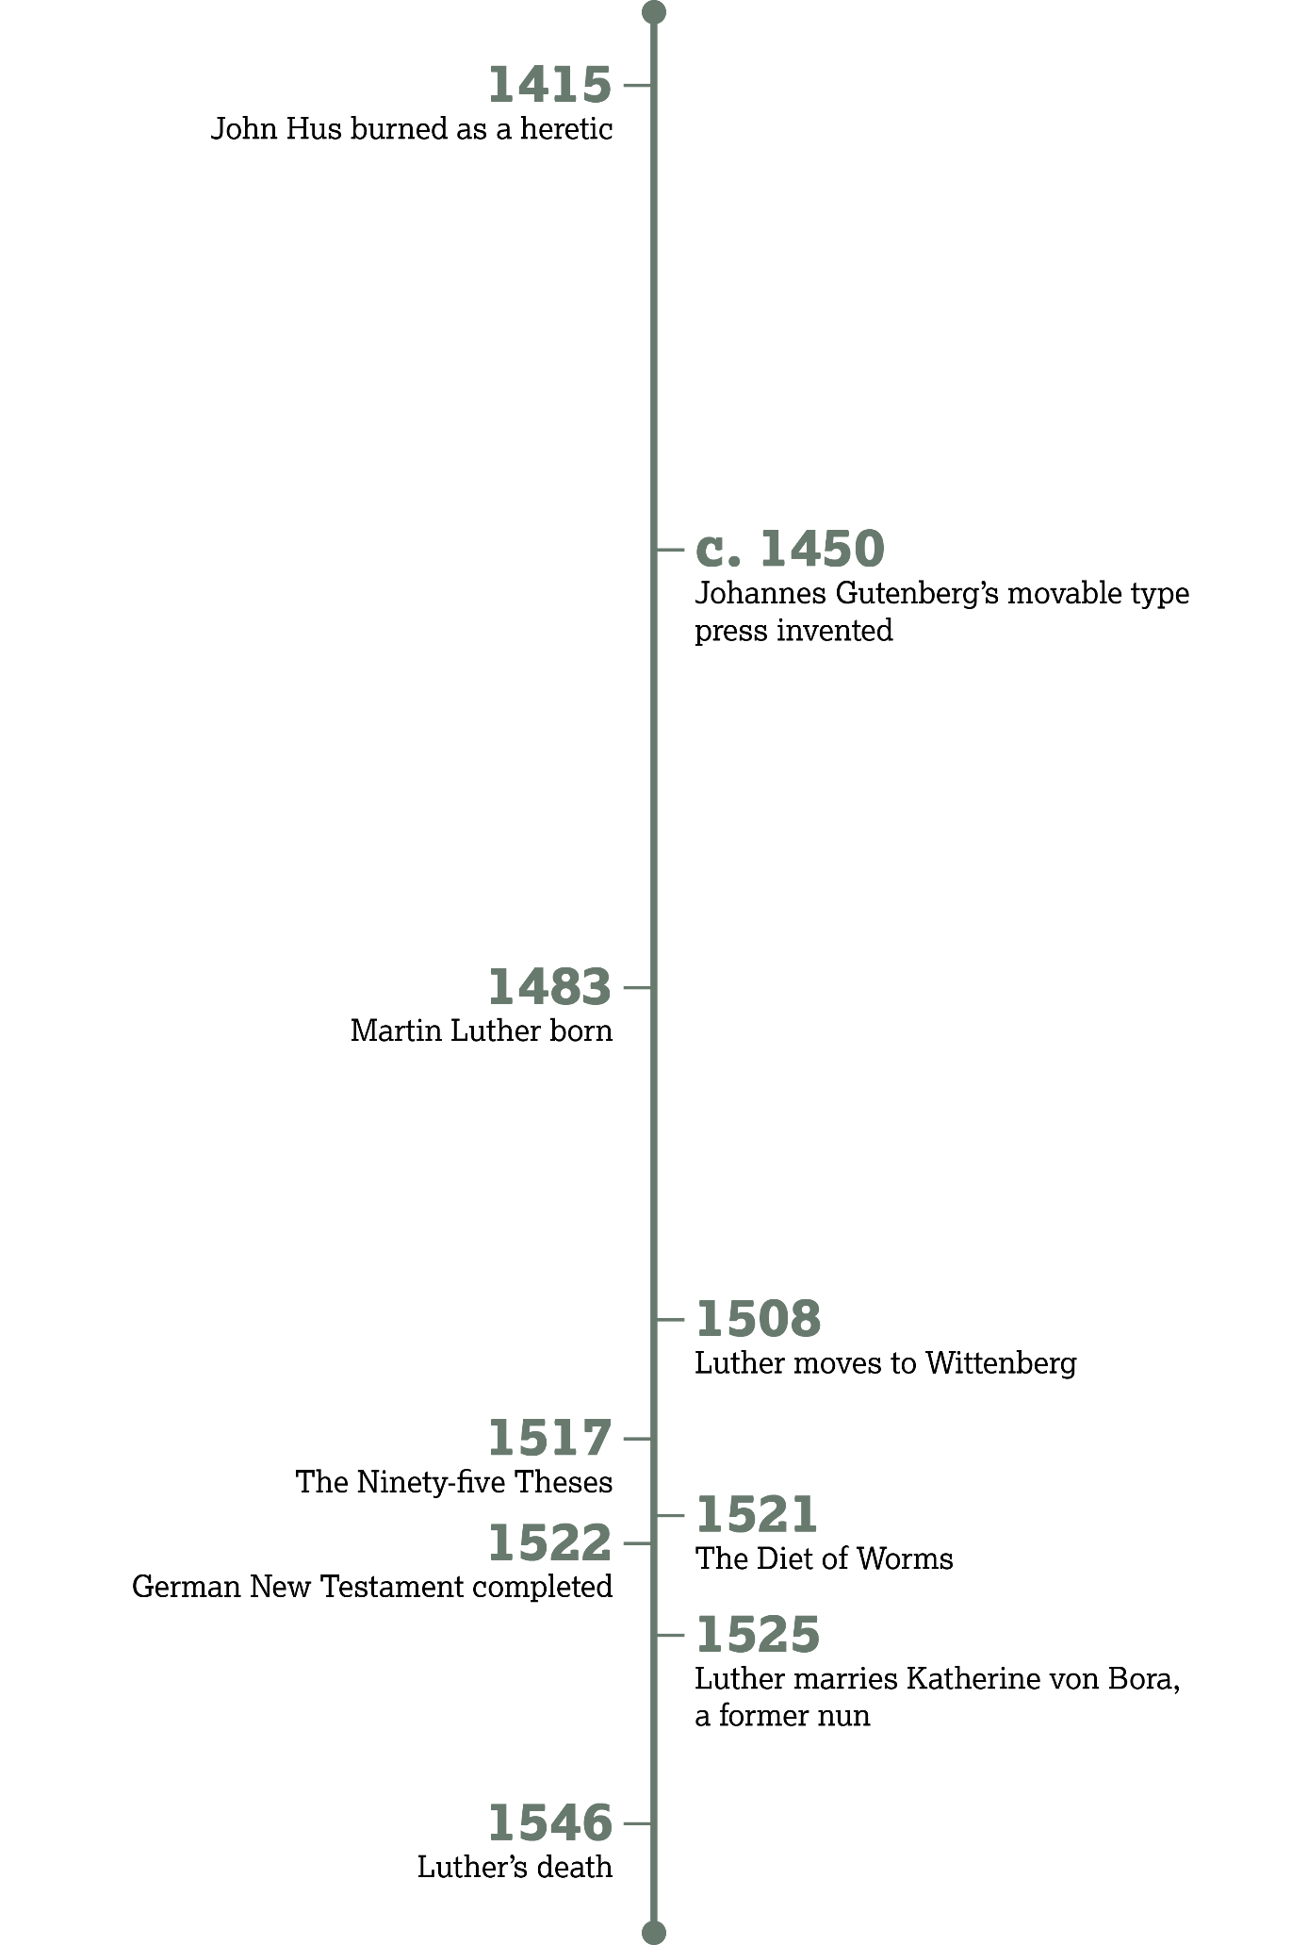

Slide 4
Martin Luther and the Roman Catholic Church
Introduction:

Slide 5
Martin himself . . . has scorned to revoke his errors . . . He has now been declared a heretic . . .
—Decet Romanum Pontificen

Slide 6
What Is the Gospel?

Slide 7
Romans 1
Paul saw himself as a servant of Jesus Christ set apart for what purpose (v. 1)?
  To share the gospel

Slide 8
Romans 1
Paul viewed the gospel as a promise from God. Where was the promise recorded (v. 2)?
  In the holy Scriptures as they revealed God’s Son

Slide 9
Definitions
Grace
  The unmerited gift of God for salvation and living in Christ
Faith
  Full confidence in something promised

Slide 10
Grace and Faith

Slide 11
Romans 1:16–17
Who or what empowers the gospel?
  God
What phrases in these verses indicate that salvation is by faith alone and not our works?
  “to everyone who believes”; “from faith to/for faith”; “the righteous/just shall live by faith”

Slide 12
What does this verse say about our salvation or justification?
Romans 3:20
  No one is justified or declared righteous by the works of the Law.

Slide 13
What does this verse say about our salvation or justification?
Romans 3:27–28
  A person is justified by faith apart from the works of the Law.

Slide 14
What does this verse say about our salvation or justification?
Romans 4:5
  Faith is counted as righteousness for those who believe God.

Slide 15
What does this verse say about our salvation or justification?
Romans 5:1–2
  Christians have been justified by faith.

Slide 16
What is the overwhelming truth Paul is communicating in these passages?

Slide 17

The Five Solas
Sola Gratia—We are saved by grace alone.
Sola Fide—This salvation comes through faith alone.
Solus Christus—Faith is in Christ alone.
Sola Scriptura—Faith and practice are revealed in Scripture alone.
Sola Deo Gloria—We live as Christians for the glory of God alone.

Slide 18
Indulgences:
The Corruption of Grace

Slide 19
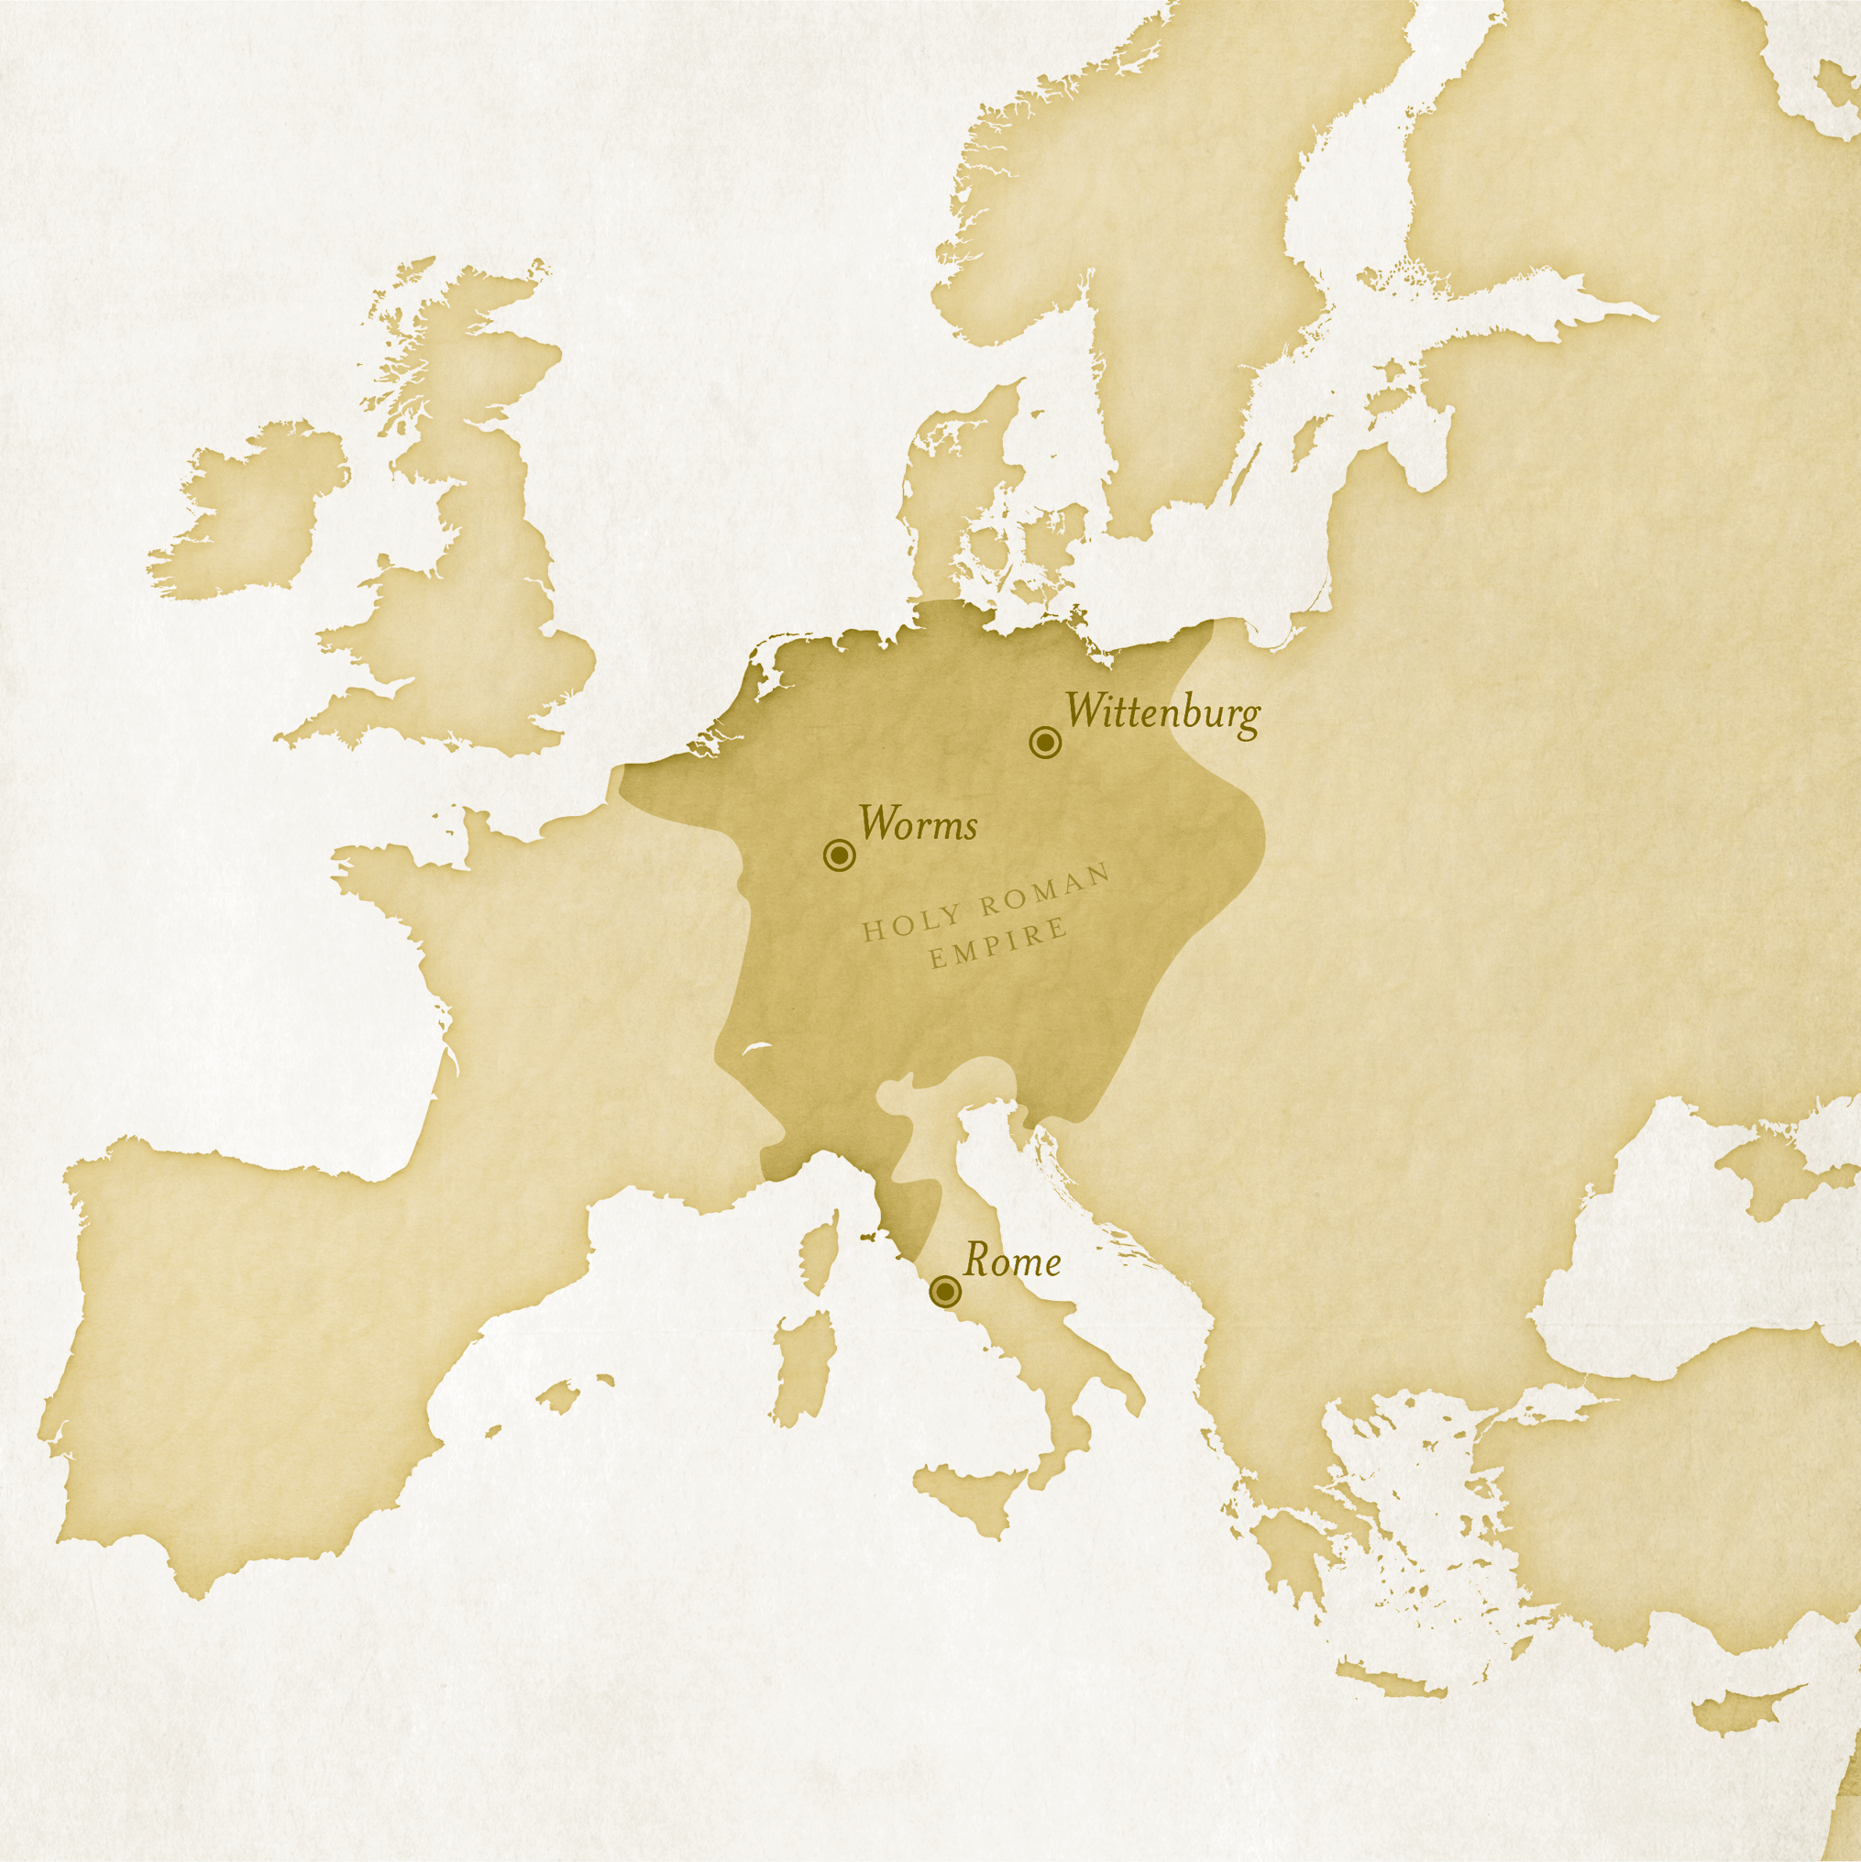

Slide 20
Luther’s Theses Against Indulgences
Would you have been convinced to reject indulgences by these arguments?

Slide 21
Luther’s Theses Against Indulgences
What do you think of Luther’s argument in thesis #82 that, if the pope had power to remove sin for money, he should instead do it merely out of love?

Slide 22
Luther’s Theses Against Indulgences
What does Luther imply about the motives of Rome in issuing indulgences?

Slide 23
What are the dangers of reducing religion to a series of rules or financial transactions?

Slide 24
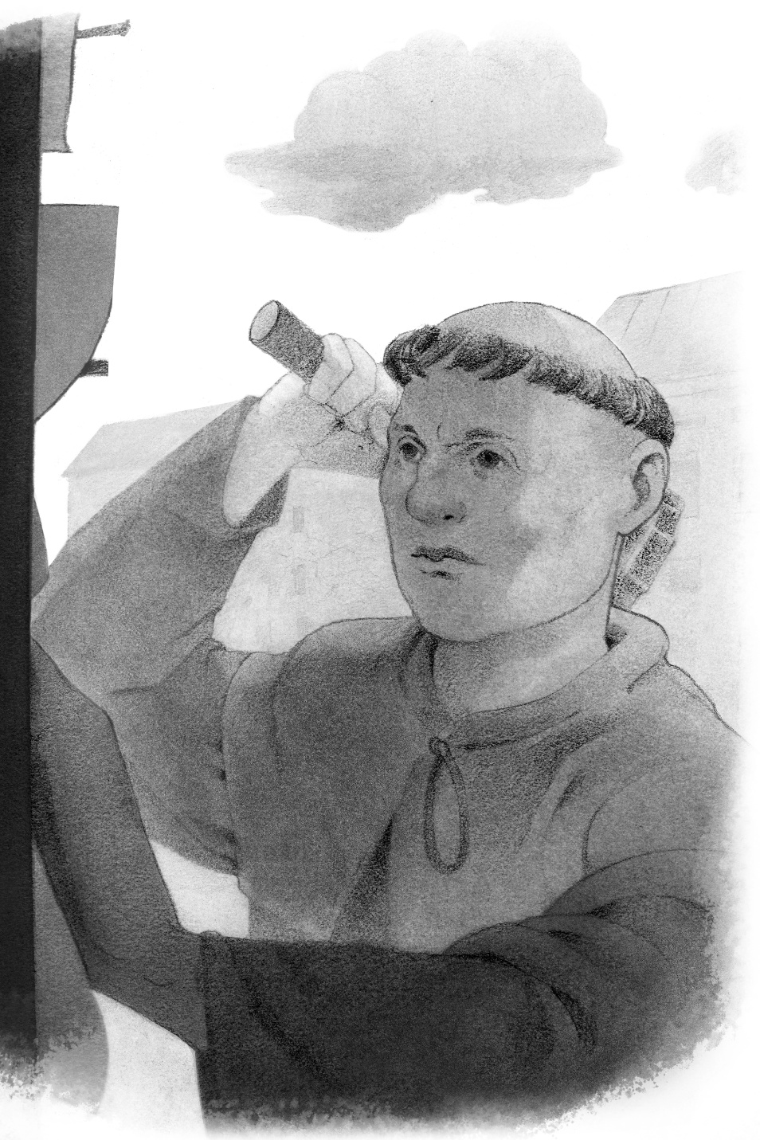
Luther on Trial
Further Reading

Slide 25
Luther on Trial
In the second paragraph of his statement, what did Luther specify should be the measure for determining if his claims about the gospel were correct?
  The writings of the prophets and apostles, the Bible

Slide 26
Luther on Trial
Why do you think that it is unsafe, as Luther stated, for a Christian to go against their conscience?
  God gave us our conscience as
  a guide.

Slide 27
How would you describe Luther’s tone or demeanor as it comes across in what he wrote?

Slide 28
What stands out to you about the reply from the chancellor of Treves? What stands out to you about Luther’s response?

Slide 31
The Word
Has Power
CHAPTER 2

Slide 32
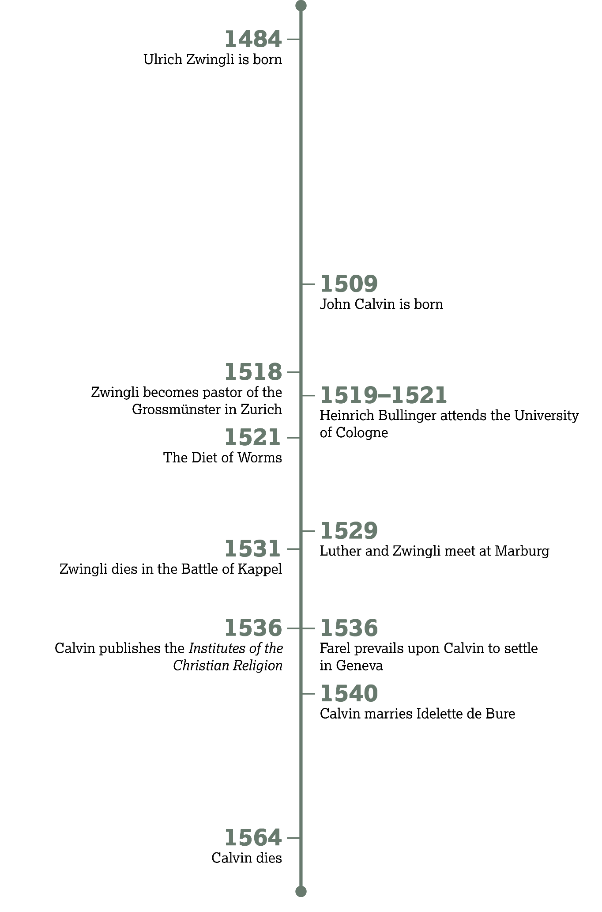

Slide 33
The Battle Between Scripture and Tradition
Introduction:

Slide 34
In short, if you want to fast, do so; if you do not wish to eat meat,
eat it not; but leave Christians a free choice in the matter.
—Ulrich Zwingli,
“Of Freedom of Choice in the
Selection of Foods”

Slide 35
What are some useful traditions?
What are signs that a traditional activity has become problematic?

Slide 36
Sola Scriptura

Slide 37
Whatsoever things are necessary to know concerning God, the works, judgments, will and commandments of God, concerning Christ, our faith in Christ, and the duties of a holy life; all those things, I say are fully taught in the Word of God.
—Heinrich Bullinger

Slide 38
Sola Scripture
What benefits come from studying God’s Word?
  Knowledge of God’s character, wisdom, discerning right and wrong, developing a biblical worldview, guidance for living, and correction for sin

Slide 39
What is the value of God’s Word and its importance in a believer’s life?

Slide 40
2 Timothy 3:10–15
What does Paul encourage Timothy to continue pursuing (v. 14)?
  The things he has heard
  and learned

Slide 41
2 Timothy 3:10–15
What has the power to make a person wise for salvation through faith in Christ (v. 15)?
  The Scriptures / the sacred writings

Slide 42
2 Timothy 3:10–15
Paul also warns that people who pursue life according to God’s Word will face what (v. 12)?
  Persecution

Slide 43
The Power of Scripture

Slide 44
What are some examples of how the Word of God can be used to teach us the truth?

Slide 45
What are some examples of how the Word of God can be used to expose false teaching?

Slide 46
What are some examples of how the Word of God can be used to correct sin in us?

Slide 47
What are some examples of how the Word of God can be used to guide us in righteous living?

Slide 48
The Power of Scripture
How would these four benefits of the Bible help us become mature and prepare us to do good works?
  As we are taught to discern between truth and falsehood, we grow more like Christ. We reject our sinful practices and seek ways to serve God in righteousness.

Slide 49
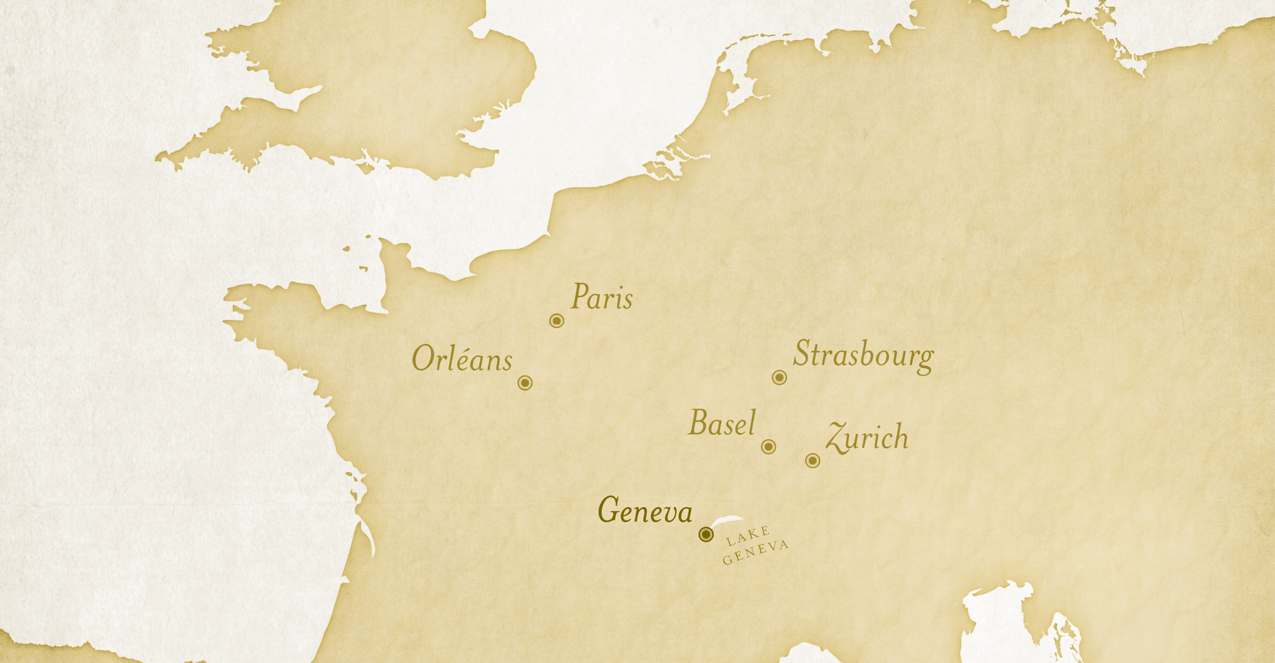

Slide 50
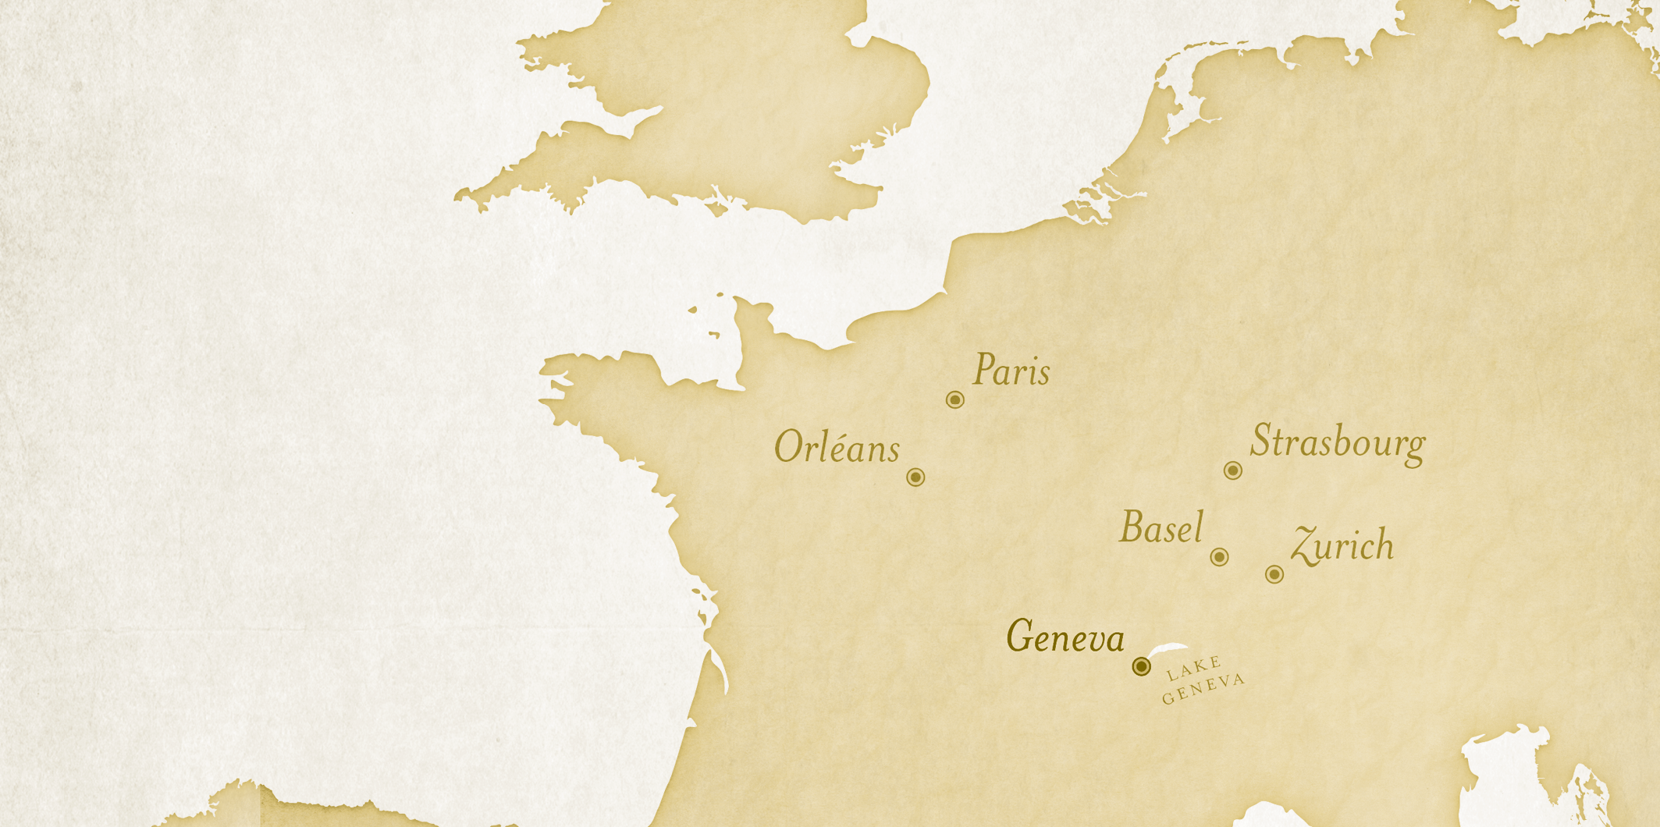
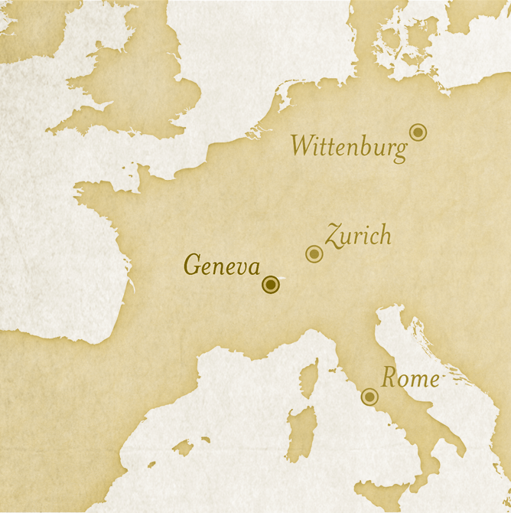

Slide 51
The Path to Geneva

Slide 52
Knowing Is
Not Enough

Slide 53
2 Timothy 4:1–2
What does Paul encourage Timothy to do?
  Preach the Word, always be ready to minister with patience

Slide 54
How can you share what God has taught you?

Slide 55
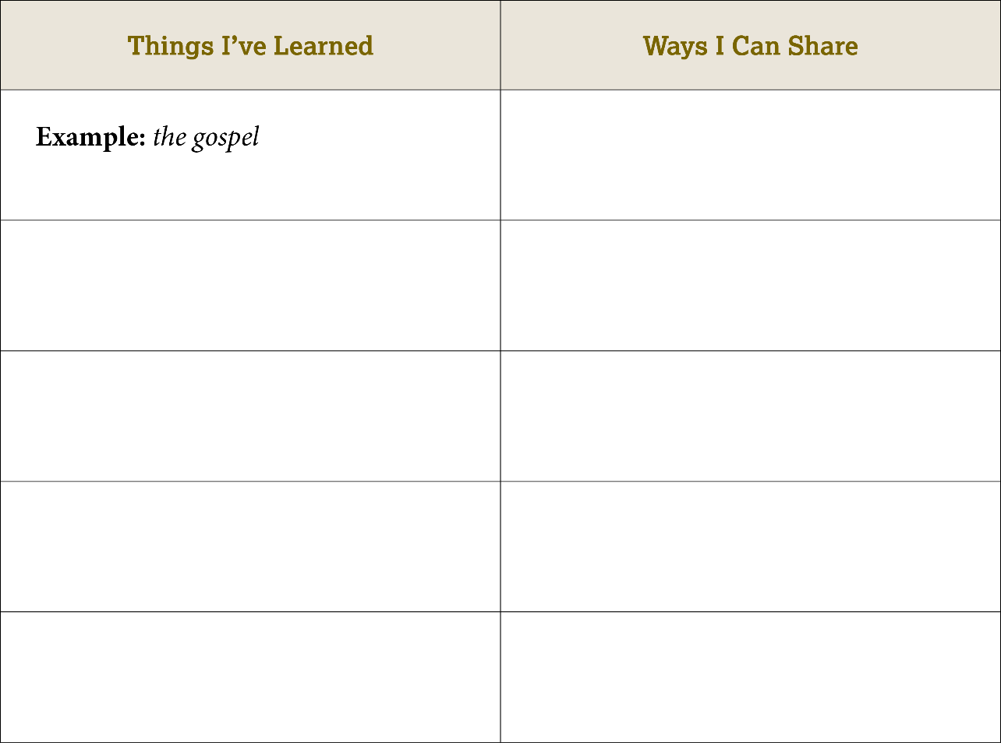
…
Promise of God’s presence
…
God’s work in
biblical stories
…
God’s promise of
strength in trials
…
God's character
…

Slide 56
Be Prepared for Some Rejection

Slide 57
2 Timothy 4:3–5
What does Paul say many people want to hear (vv. 3–4)?
  Many people want to hear myths or fables that fit what they want to hear and already believe.

Slide 58
2 Timothy 4:3–5
How should we respond to rejection of God’s message (v. 5)?
  We should remain steady and confident, continuing to share the gospel and serve.

Slide 59
Broadcasting the Word

Slide 60
We believe the authority of the Holy Scripture to be above the authority of the Church.
—Cyril Lucaris

Slide 61
Hence it is easy to understand that we must give diligent heed both to the reading and hearing of Scripture, if we would obtain any benefit from the Spirit of God . . .
—John Calvin,
Institutes of the Christian Religion

Slide 62
Calvin on
Knowing
God
Further Reading:

Slide 63
Calving on Knowing God
Based on Calvin’s statement in the second paragraph, what are some of the reasons we should be thankful that God chose to give us the Bible?
  Scripture prompts us to remember God, and it can protect us from doctrinal error and false religion.

Slide 64
Calving on Knowing God
Summarize Calvin’s explanation, found in the third paragraph, for why the church does not grant Scripture its authority.
  The teaching of the prophets and apostles is found in Scripture, thus it existed before the Church.

Slide 65
What have you seen in God’s creation that reveals His majesty?
What does God’s written Word reveal to us that creation cannot?

Slide 68
Despite Earthly Powers
CHAPTER 3

Slide 69
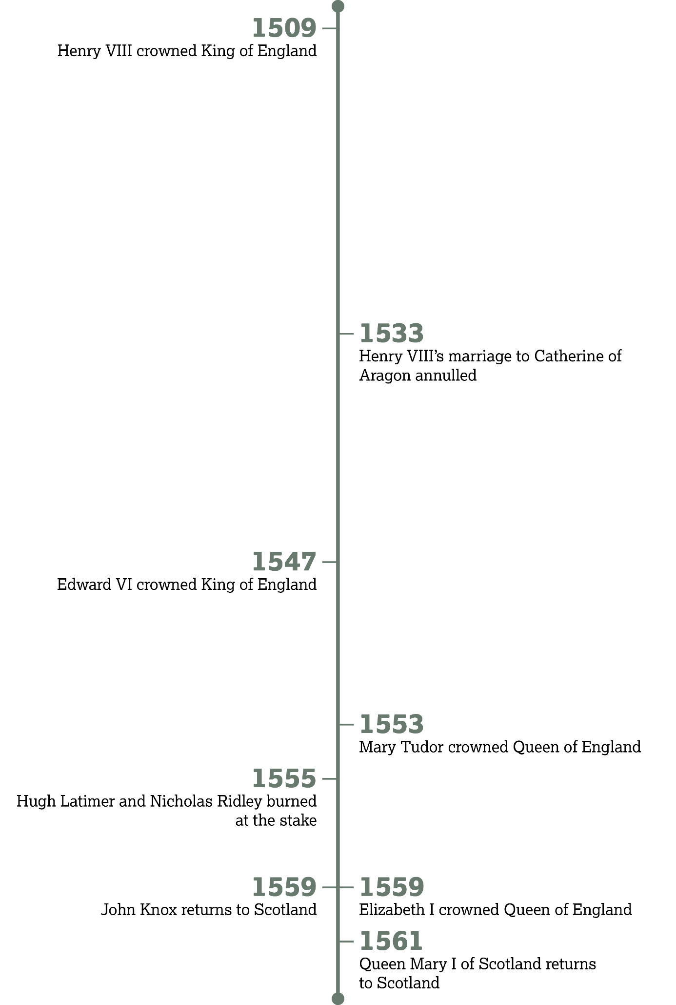

Slide 70
The Tudor Dynasty of England
Introduction:

Slide 71


Slide 72
In the Face of Opposition

Slide 73
Acts 4:1–4
How did the leaders react to Peter and the apostles’ proclamation of Jesus Christ?
  They were annoyed and angry. They arrested the apostles.

Slide 74
Acts 4:1–4
How did God work despite this opposition?
  Many who heard the gospel believed.

Slide 75
Acts 4:5–12
How would you describe Peter’s response to the religious leaders?
  Bold, specific, unapologetic, accusatory

Slide 76
Acts 4:5–12
Verses 11–12 capture the Reformation doctrine of solus Christus. How would you summarize these two verses?
  All spiritual power rests in Jesus, and He is the only way of salvation.

Slide 77
Acts 4:13–22
How did Peter and John respond to the council’s command to stop preaching in Jesus’ name?
  We will obey God and preach Christ even if you command us otherwise.

Slide 78
Give an example of a law where a Christian may have to disobey a human authority to obey God.

Slide 79
God Is Sovereign Over Rulers

Slide 80
Acts 4:23–28
You may have expected the apostles’ arrests to instill fear in the early Christians. Instead, how did they respond to the news (v. 24)?
  They praised God.

Slide 81
Acts 4:23–28
After quoting Psalm 2:1–2, the believers stated that plotting against God is pointless and vain. What example of a failed plot do they point to in verses 27–28?
  The crucifixion of Jesus

Slide 82
Acts 4:23–28
Despite all the plans against Jesus by His enemies, whose will ultimately triumphed (v. 28)?
  God’s will

Slide 83
How do you think this understanding affected the early believers?

Slide 84
Proclaiming the Sovereign God

Slide 85
Acts 4:31
What was God’s immediate response to this prayer?
  The place where the apostles were gathered shook.

Slide 86
Acts 4:31
What was the ongoing response of the believers?
  They spoke God’s Word with boldness.

Slide 87
Acts 4:31
According to the verse, what was the source for this boldness?
  The Holy Spirit

Slide 88
. . . the word of God preached by the mouth of man, is not a vain sound, and words spoken without a purpose; but is the summoning of God himself, forewarning men before the judgment come.
—John Knox,
“A Letter to the People of Edinburgh”

Slide 89
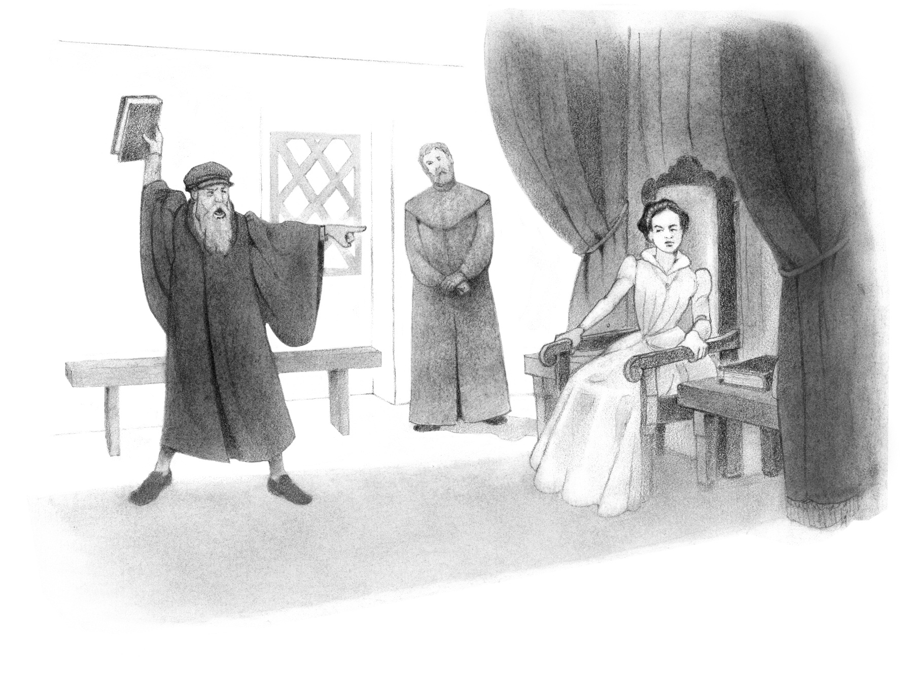
John
Knox
History:

Slide 90
The Thirty-Nine Articles
Further Reading:

Slide 91
The Thirty-Nine Articles
According to the first article in this list, what contains everything necessary for our salvation?
  Holy Scripture

Slide 92
Summarize one article in your own words.

Slide 93
Did you find any of these articles confusing? If so, why?
Do you think people still disagree with these doctrinal points today? What are some examples?

Slide 96
Catholic Reforms
CHAPTER 4

Slide 97
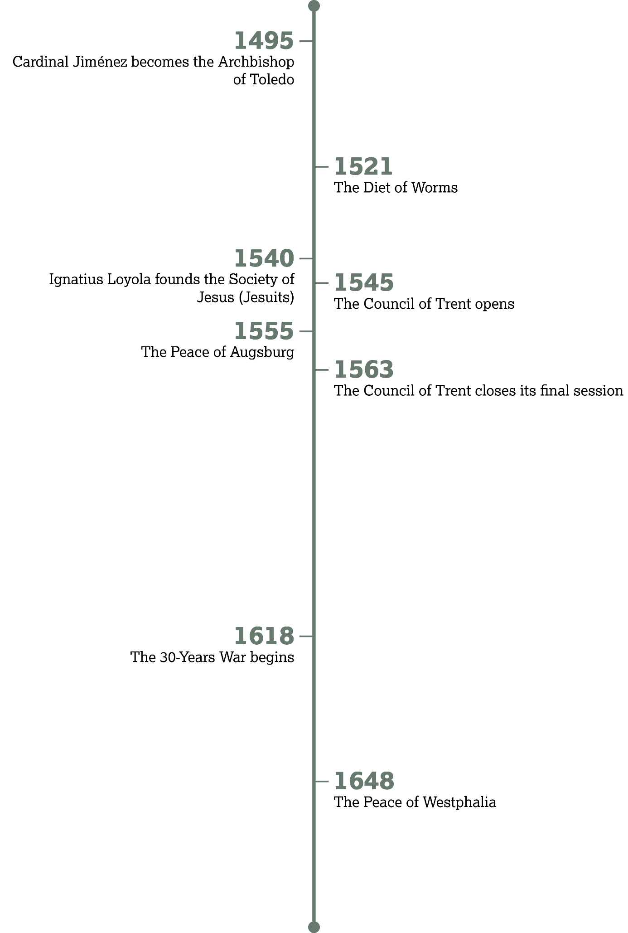

Slide 98
Changes in the Roman Catholic Church
Introduction:

Slide 99
Focusing on Externals

Slide 100
Matthew 23:25–28
What contrasting types of change does Jesus mention four times in these verses?
  Inward change vs.
  Outward change

Slide 101
Matthew 23:25–28
Which of these changes did the Pharisees emphasize?
  Outward change

Slide 102
Matthew 23:25–28
Jesus says that both types are important, but priority should be given to which type?
  Inward change

Slide 103
Write down three examples of your church’s practices under each of the columns below.

Slide 104
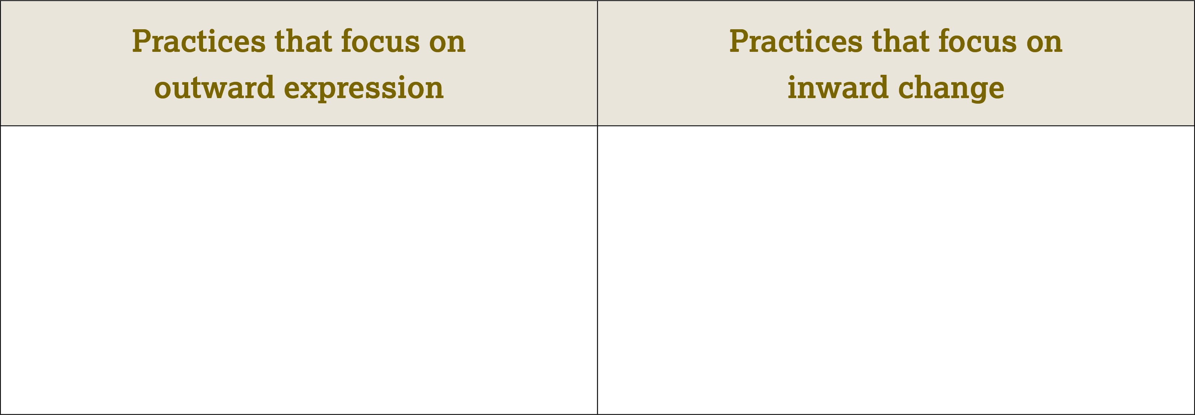
Examples:
The clothing we wear to church
The times we meet
The way we decorate the
church building
The names we give to leaders in
the church
Examples:
The preaching of the Word
Public prayer
Corporate worship
Sharing the gospel

Slide 105
Jesus blessed both inward and outward expressions of righteousness (Matt. 23:27).
How can we maintain a balance between these two aspects?
How can we personally work to keep inward righteousness a priority?

Slide 106


Slide 107
Cardinal
Jiménez de Cisneros
History:

Slide 108
Builders of Tombs

Slide 109
Matthew 23:29–31
How did the scribes and Pharisees honor dead heroes (v. 29)?
  They built tombs and decorated monuments.

Slide 110
Matthew 23:29–31
What evil of the past did the Pharisees claim they would not have participated in (v. 30)?
  Killing the prophets

Slide 111
Matthew 23:29–31
What irony can you see between the Pharisee’s self-righteous claim and their eventual condemnation of Jesus?
  They claimed they would not
  have killed God’s prophets, but
  they encouraged the crucifixion
  of the Messiah.

Slide 112
Matthew 23:32–36
Summarize the way Jesus says the Pharisees will respond to God’s messengers.
  They will kill some and cruelly mistreat others, driving them out of their cities.

Slide 113
What are some benefits of remembering and honoring Christians of the past?
What are some dangers? Is there a good balance?

Slide 114
The Wars of Religion

Slide 115
How would you defend the idea of freedom of religion?

Slide 116
No Peace Apart from Christ

Slide 117
Matthew 23:37–39
Who is the only person who offers true peace?
  Jesus

Slide 118
Matthew 23:37–39
What happens to those who refuse Jesus’ peace (vv. 38–39)?
  They are left desolate and separated from Christ.

Slide 119
The Council of Trent
Further Reading:

Slide 120
The Council of Trent
What could be a potential danger of accepting noncanonical books for Christian teaching?
  Possibilities include the danger
  of accepting false teaching or requiring practices that God never intended to be normative.

Slide 121
The Council of Trent
In your own words, how would you contrast salvation that comes through works as opposed to salvation that comes through faith?

Slide 122
The Council of Trent
How does Trent’s prohibition against drinking the cup contradict Jesus’ teaching found in Scripture (1 Cor. 11:23–28)?
  The passage in 1 Corinthians 11 indicates that Jesus was setting a precedent for all believers to follow. That precedent involved both eating the bread and drinking the cup.

Slide 123
Which of these decrees do you think is the most dangerous or harmful?

Slide 124
Have you ever heard of any
of the noncanonical books mentioned in this section?

Slide 125
Were you able to identify all the canonical books, even though some were spelled differently than we are used to seeing them today?

Slide 128
Conflicts and
Different Paths
CHAPTER 5

Slide 129
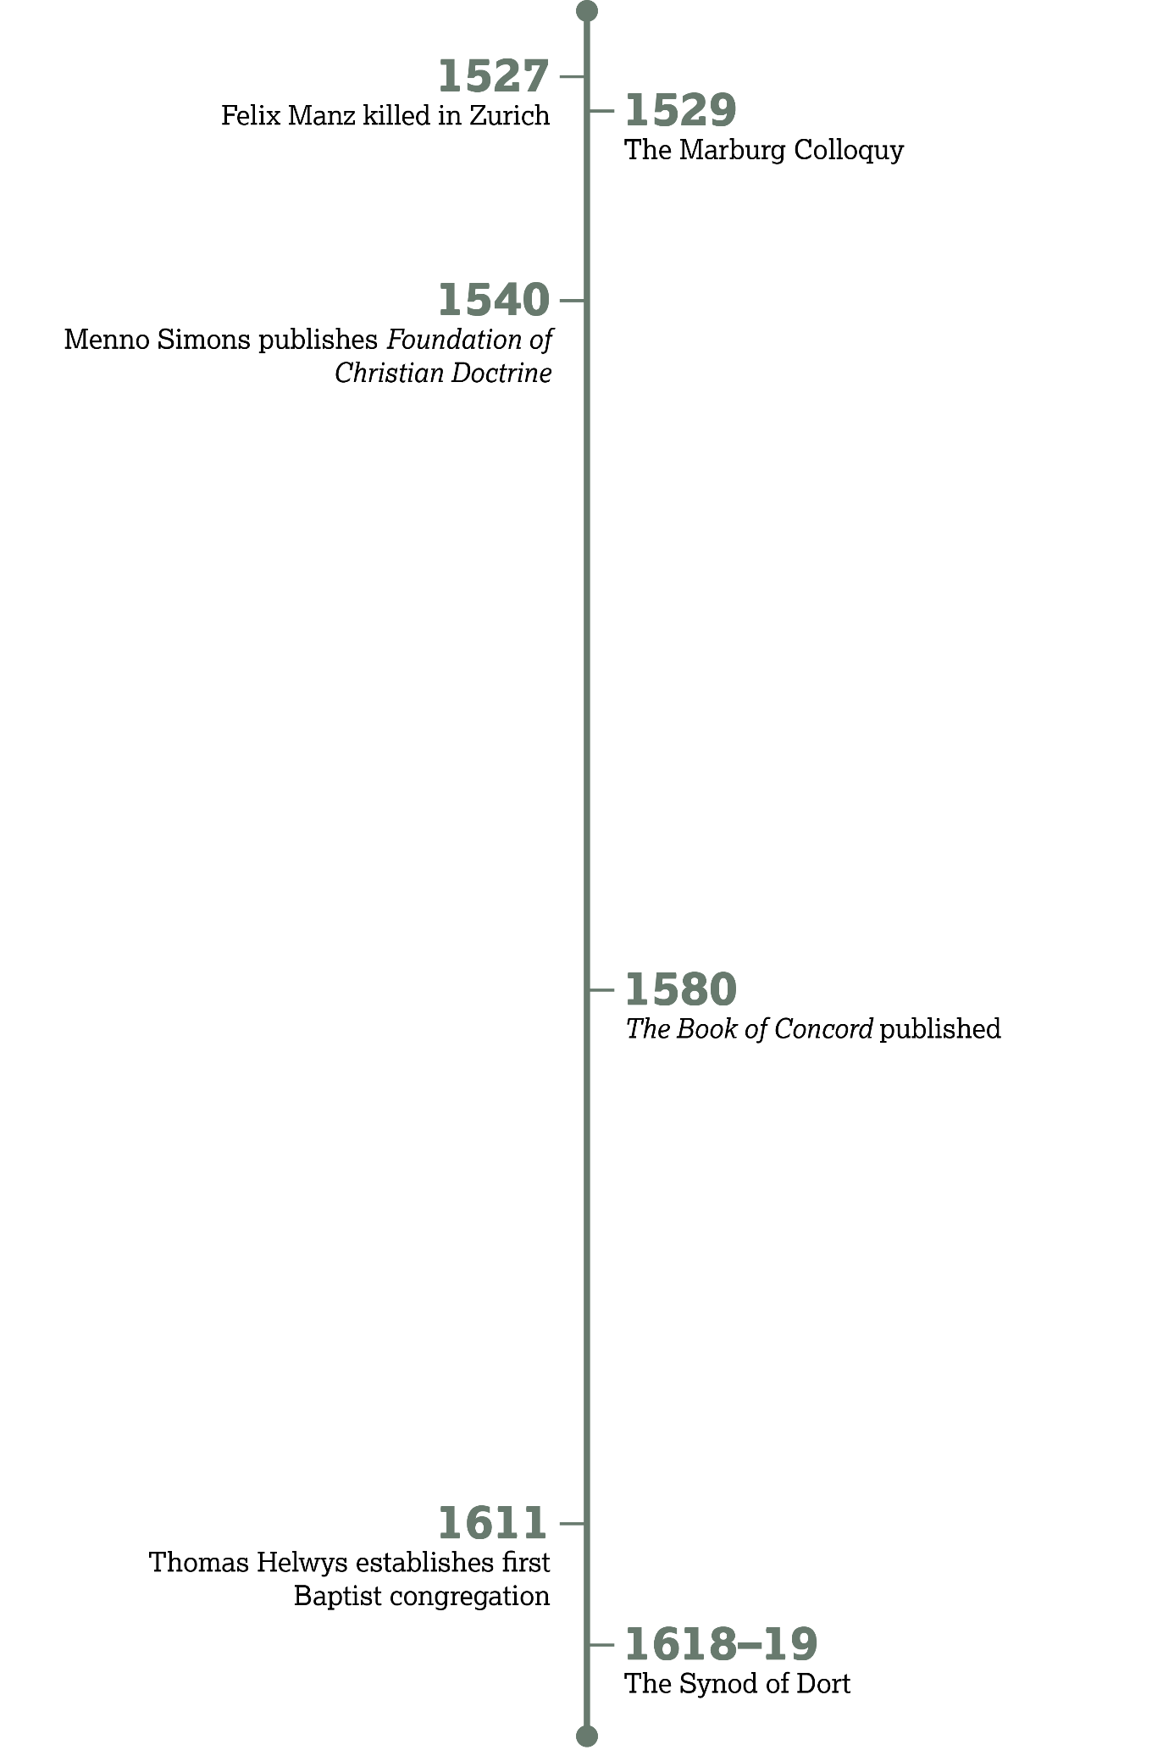

Slide 130
Differences and Conflicts
Introduction:

Slide 131
Coming to Grips with Christian Diversity

Slide 132
Ephesians 4:11–16
What two purposes, mentioned in verses 11–12, did God provide the spiritual leaders for?
  (1) To equip believers to minister and (2) to build up (edify) believers in the body
  of Christ

Slide 133
Ephesians 4:11–16
Based on the final phrases of verses 13 and 15, what would you say is the goal of Christian growth?
  To live and think like Christ

Slide 134
Ephesians 4:11–16
Is this growth instantaneous or a process? Support your answer from this passage.
  Christian growth is an ongoing process that requires help from spiritual leaders (vv. 11–12). It is a maturing process (vv. 13–14) supported by every member of the body (vv. 15–16).

Slide 135
Ephesians 4:11–16
What spiritual fruit is essential among believers if this mutual growth is to take place (vv. 15–16)?
  Love

Slide 136
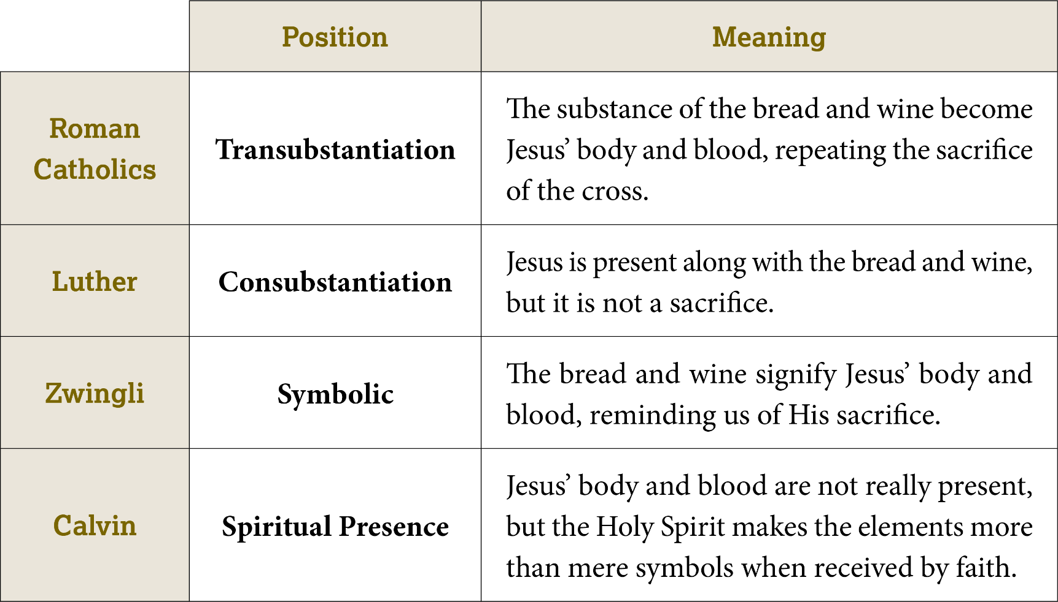

Slide 137
The Synod of Dort, 1618–19

Slide 138
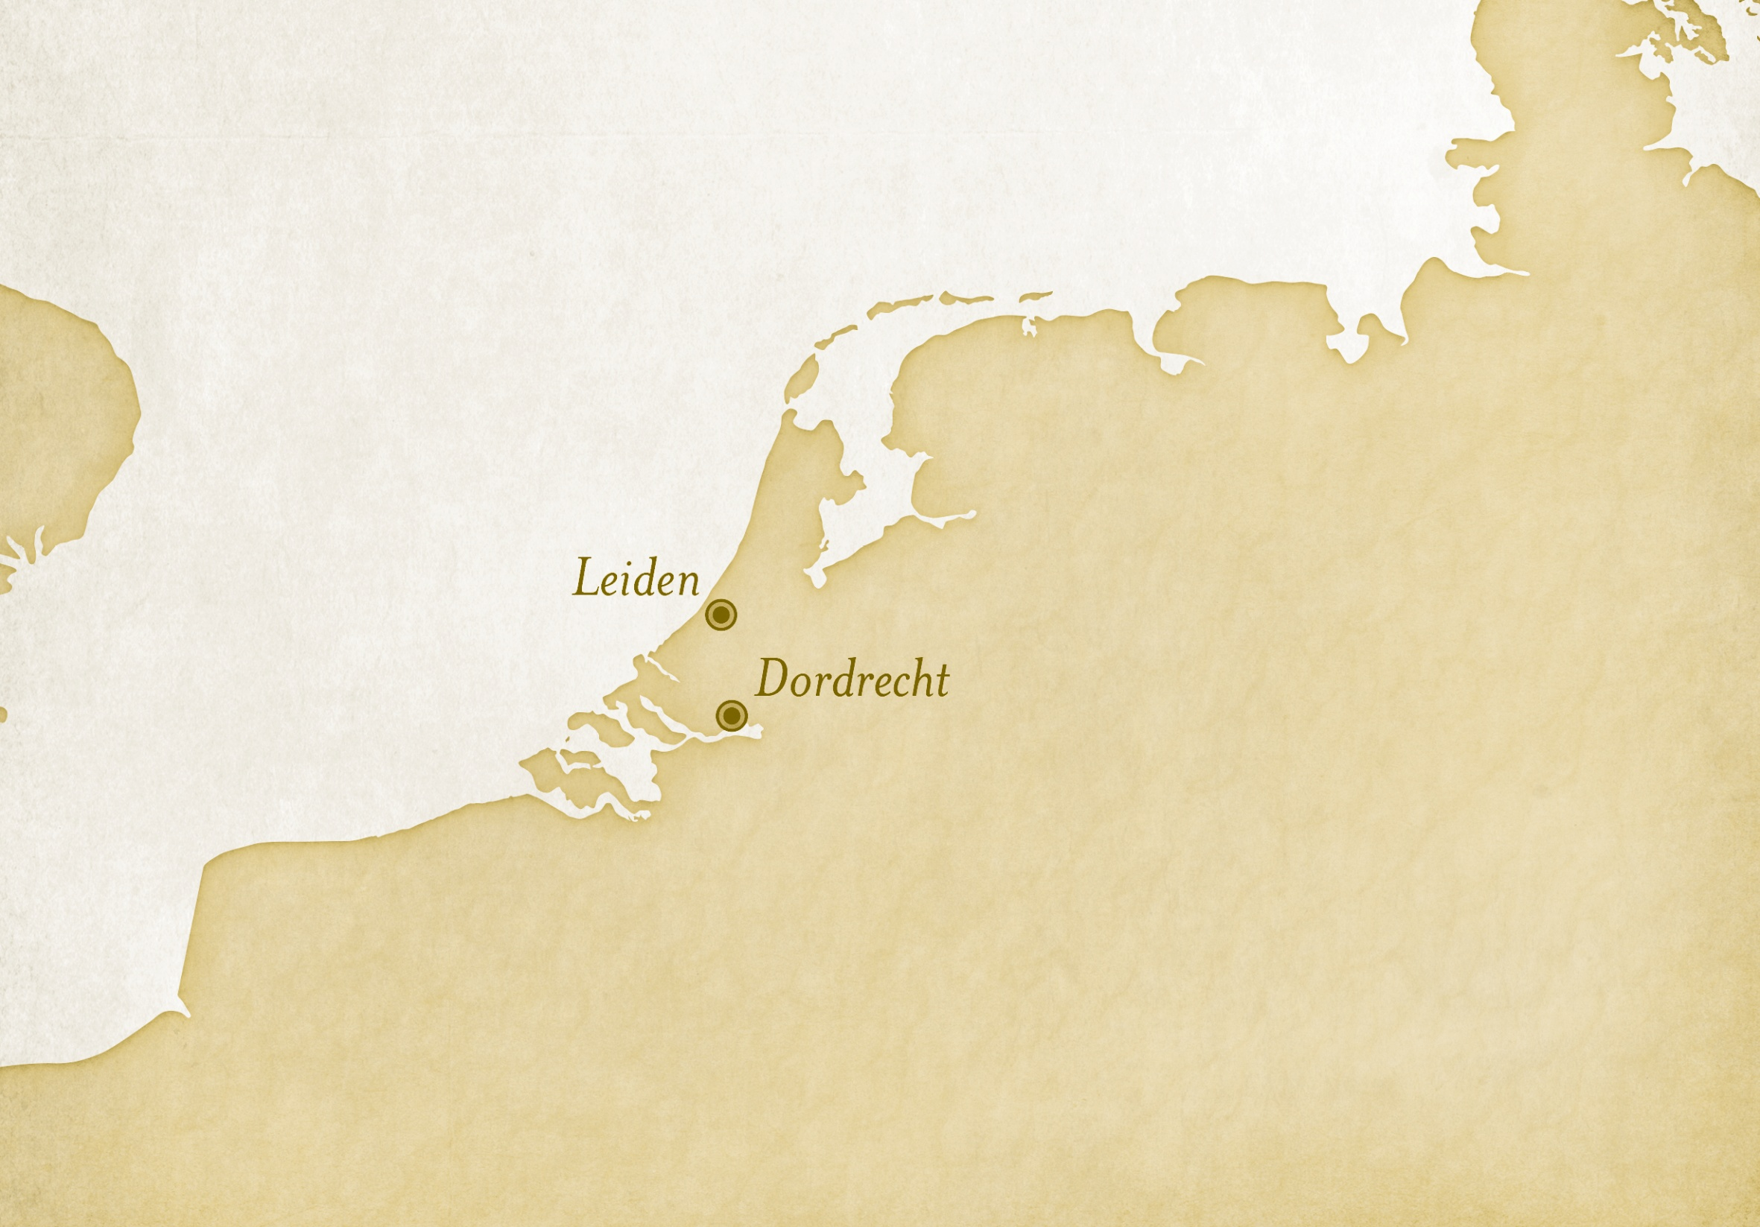

Slide 139
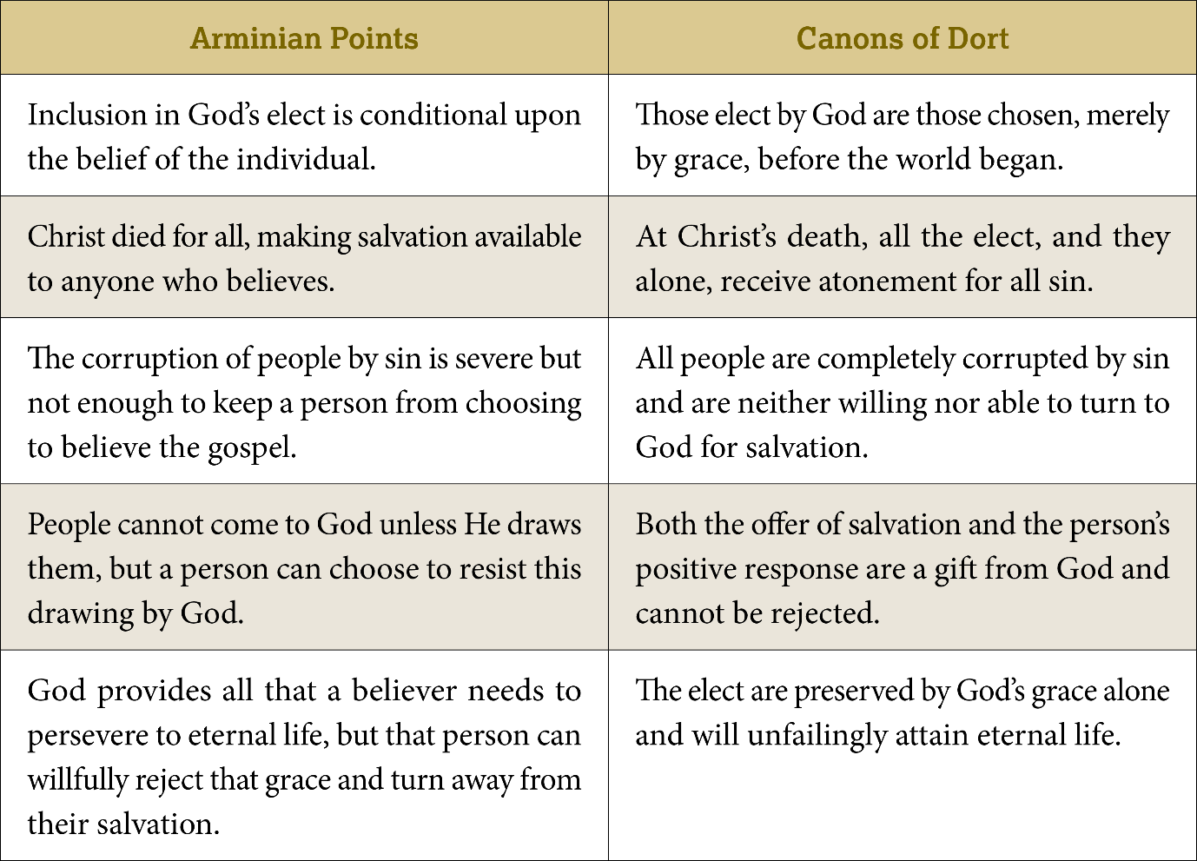

Slide 140
The Synod of Dort, 1618–19
What does your church teach about this area of doctrine?

Slide 141
The Synod of Dort, 1618–19
Is it possible to disagree respectfully on these points?
If so, how?

Slide 142
Anabaptists: Reform Without Princes

Slide 143
. . . I have now clearly learned and know of a surety that baptism is nothing else than a dying to the old man and the putting on of a new . . .
—Conrad Grebel

Slide 144
Baptist Beginnings

Slide 145
Summarize the truth being expressed.
Mark 9:38–41
  We should not stop others from serving just because they are not part of our group.

Slide 146
Summarize the truth being expressed.
Phil. 1:15–18
  We can be thankful that Christ is being proclaimed even if the motives of the proclaimers are not always good.

Slide 147
Felix Manz
Further Reading:

Slide 148
Felix Manz
In the first paragraph, what does Manz say a person obtains when they come to Christ in genuine repentance?
  The heaven of eternal joy

Slide 149
Felix Manz
Manz contrasts love with boasting, denouncing, and threatening. Explain how one of these attitudes might prompt a Christian to mistreat other Christians over doctrinal disagreements?

Slide 150
Felix Manz
The final paragraph lists sinful attitudes and actions that should be uncharacteristic of Christians. What attitudes and actions should we show to those we disagree with?
  Some possible answers include love, kindness, patience, and humility

Slide 151
What stands out to you about Manz’s words?
Do you hold any beliefs so strongly that you would consider dying for them?

Slide 152
If you were facing death, as Manz was, what would you want to write to encourage other believers?

Slide 155
Missions Constrained
CHAPTER 6

Slide 156
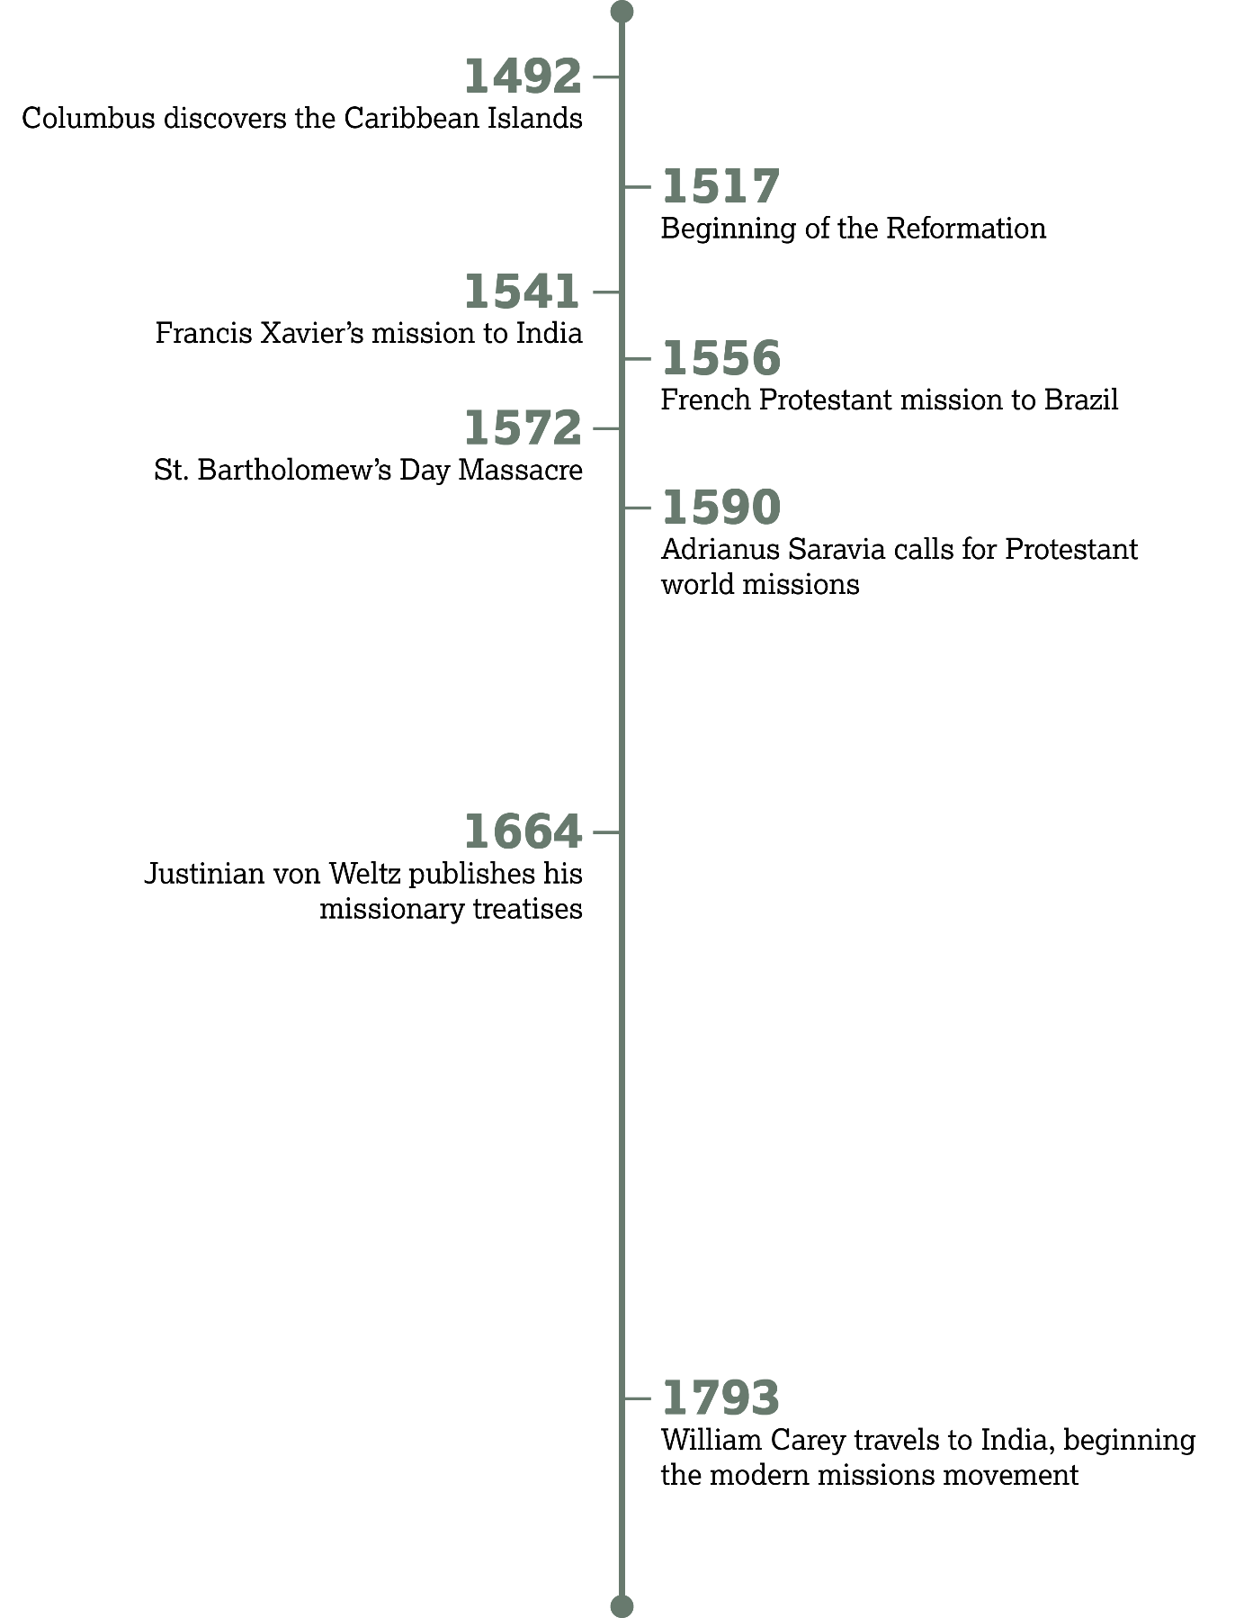

Slide 157
International
Missions
Introduction:

Slide 158
Why So Few?

Slide 159
Matthew 23:15
Jesus was likely using some hyperbole to express His opinion of the Pharisees’ missionary efforts. How would you summarize His assessment?
  The Pharisee missionaries were fruitless and even harmful to their proselytes.

Slide 160
Matthew 23:15
Would you consider this kind of missionary effort evidence of God’s approval on a movement?
  No

Slide 161
Matthew 23:15
If quantity of missionary effort is not the best measurement of God’s approval, what qualities would you consider most important?
  Possible answers include clear teaching of God’s Word, active proclaiming of the gospel, or visible expressions of God’s love.

Slide 162
Matthew 28:16–20
What elements of these verses indicate Jesus meant them to apply to all believers throughout the Church age?
  The Great Commission is tied to Jesus’ continuing authority and power in verse 18. Also, Jesus promised His presence, explaining the power to fulfill His commission would continue to the “end of the age/world.”

Slide 163
How can every believer be expected to obey the Great Commission?

Slide 164
How can you take part in going into all the world to proclaim the gospel of Christ?

Slide 165
Acts 1:6–8
Does Jesus’ response indicate that civil borders should limit the spread of the gospel?
  No

Slide 166
Acts 8:1–4
How did the early Christians respond to opposition from civil leaders in Jerusalem?
  They scattered from the city, preaching the gospel everywhere they traveled.

Slide 167
Do you know of any countries where it might be dangerous to share the gospel?

Slide 168
Sparks of Missionary Promise

Slide 169


Slide 170
Sparks of Missionary Promise
What opportunities does your schedule provide for sharing the gospel?

Slide 171
How can God use everyday activities as opportunities to testify for Christ?

Slide 172
The injunction to preach the gospel to all nations of unbelievers has respect not only to the age of the Apostles, but to all ages to come till the end of the world.
—Adrianus Saravia,
A Treatise on Different Degrees
of the Christian Priesthood

Slide 173
1 Corinthians 16:7–9
Consider internal difficulties (struggles within the heart of the missionary or within the supporting churches and institutions).
  Some possible responses would include fear, spiritual struggles, general apathy of the Church, etc.

Slide 174
1 Corinthians 16:7–9
Consider external difficulties (opposition from outside of the church).
  Some possible responses would include government prohibitions, geographic difficulties, the cost of ministering abroad, etc.

Slide 175
Baron Justinian von Welz
Further Reading:

Slide 176
Baron Justinian von Welz
According to the first point, what is God’s will?
  It is God’s will that everyone would be saved.

Slide 177
Baron Justinian von Welz
Can you think of anyone from history who set a “glorious example” to share the gospel?
Or perhaps you have met some missionaries that your church supports?

Slide 178
Baron Justinian von Welz
What argument does Welz make in his third point? Summarize it in your words.
  It’s contradictory for Christians to pray that God would save lost souls while not somehow contributing toward the cause of missions.

Slide 179
Which of these four motivations for taking the gospel to all nations do you find most persuasive?

Slide 180
Can you think of any other reasons we should want to participate in and support world missions?

Slide 183
An Explosion of Pietism
CHAPTER 7

Slide 184
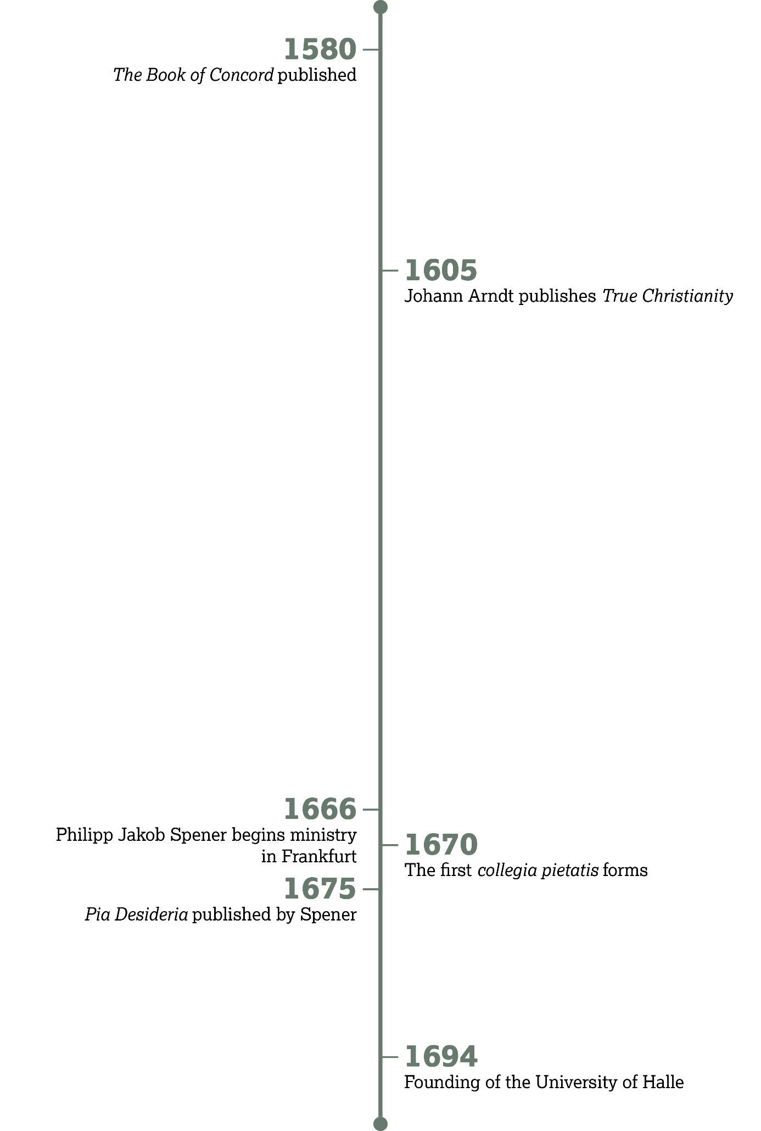

Slide 185
Pietism Defined
Introduction:

Slide 186
Revelation 3:1–6
What was Sardis’s reputation?
  Being alive

Slide 187
Revelation 3:1–6
What did Jesus identify as their true condition?
  They were dead.

Slide 188
Revelation 3:1–6
How would you summarize Jesus’ advice to the church in Sardis (vv. 2–3)?
  Wake up (watch) and strengthen what remains. Remember the truth of Christ and repent.

Slide 189
Wake Up

Slide 190
I am well aware that not all readers are equipped with the same gifts, nor, so to speak, with the same tools; but, God will be pleased with even the simple [ones] . . .
—Philipp Jakob Spener,
The Necessary and Useful
Reading of the Holy Scripture

Slide 191
Hebrews 10:19–25
In your own words, what great privilege has Jesus provided for believers, according to verses 19–22?
  We can draw near to God.

Slide 192
Hebrews 10:19–25
Given this amazing access to God, what two admonitions does the author of Hebrews give?
  Hold fast to the hope promised by God (v. 23)
  Consider ways to stir up one another to love and good works (v. 24).

Slide 193
Hebrews 10:19–25
What are some ways you have been encouraged toward love and good works by meeting with believers (v. 25)?

Slide 194
Strengthen What Remains

Slide 195
But should Christians only deal with God’s Word individually? No, but they should also deal with it with others for their own edification.
—Philipp Jakob Spener,
The Spiritual Priesthood

Slide 196
Acts 2:42–47
How did the Church function from the very beginning (vv. 42–43)?
  The church gathered for teaching, fellowship, and prayer. Their practice of piety testified to the working of God.

Slide 197
Acts 2:42–47
How did the Church function from the very beginning (vv. 44–45)?
  The church, because they were often together, knew of one another’s needs and were able to meet those needs as a body.

Slide 198
Acts 2:42–47
How did the Church function from the very beginning (vv. 46–47)?
  The church met in public and in private. These meetings were characterized by joy and praise.

Slide 199
These activities will look different in various cultures, but they are part of the inherent nature of the Church.
How do these characteristics manifest in your church?

Slide 200
Acts 2:42–47
According to the end of verse 47, what did the Lord do as the church functioned in this way?
  He added to the Church day by day.

Slide 201
Pia Desideria

Slide 202
You also hear the divine Word. This is rightly done! But it is not enough that your ears hear it; do you also allow it to penetrate inwardly into your heart and allow such heavenly food to be digested there, so that you receive juice and strength from it, or does it go in one ear and out the other?
—Philipp Jakob Spener,
Pia Desideria

Slide 203
The first four points focus on individual spirituality, while the
final two focus on training of clergy.
Why do you think Spener may have organized the list in this way?

Slide 204
Is it possible to have spiritual believers with unspiritual leadership?
Do spiritually-minded leaders make the people’s growth easier?

Slide 205
Pia Desideria
Which of these reforms would you say is still the most urgent today?

Slide 206
Do you see personal piety or spiritual leadership as more important?

Slide 207
Revelation 3:1–6
According to verse 4, what is the implied result of sleep (spiritual apathy)?
  It produces sin illustrated by soiled garments.

Slide 208
Revelation 3:1–6
As we wake up and strengthen ourselves in truth and good works (v. 2), we conquer through the Spirit’s power (v. 5). What does Christ promise to those who conquer?
  They will be clothed in white garments and have their names written in the Book of Life.

Slide 209
John Arndt,
True Christianity
Further Reading:

Slide 210
John Arndt, True Christianity
What elements of Pietism do you see in this passage?
  The encouragement to live for Christ and not for this world

Slide 211
John Arndt, True Christianity
Where is the power to live this way found?
  In the Spirit working by faith

Slide 212
How would you summarize
2 Corinthians 5:15 in your own words? What do you find comforting or encouraging about this verse?

Slide 213
What are some ways you can put this verse into practice in your own life?

