Slide 2
Arise, My Soul, Arise!
CHAPTER 8

Slide 3
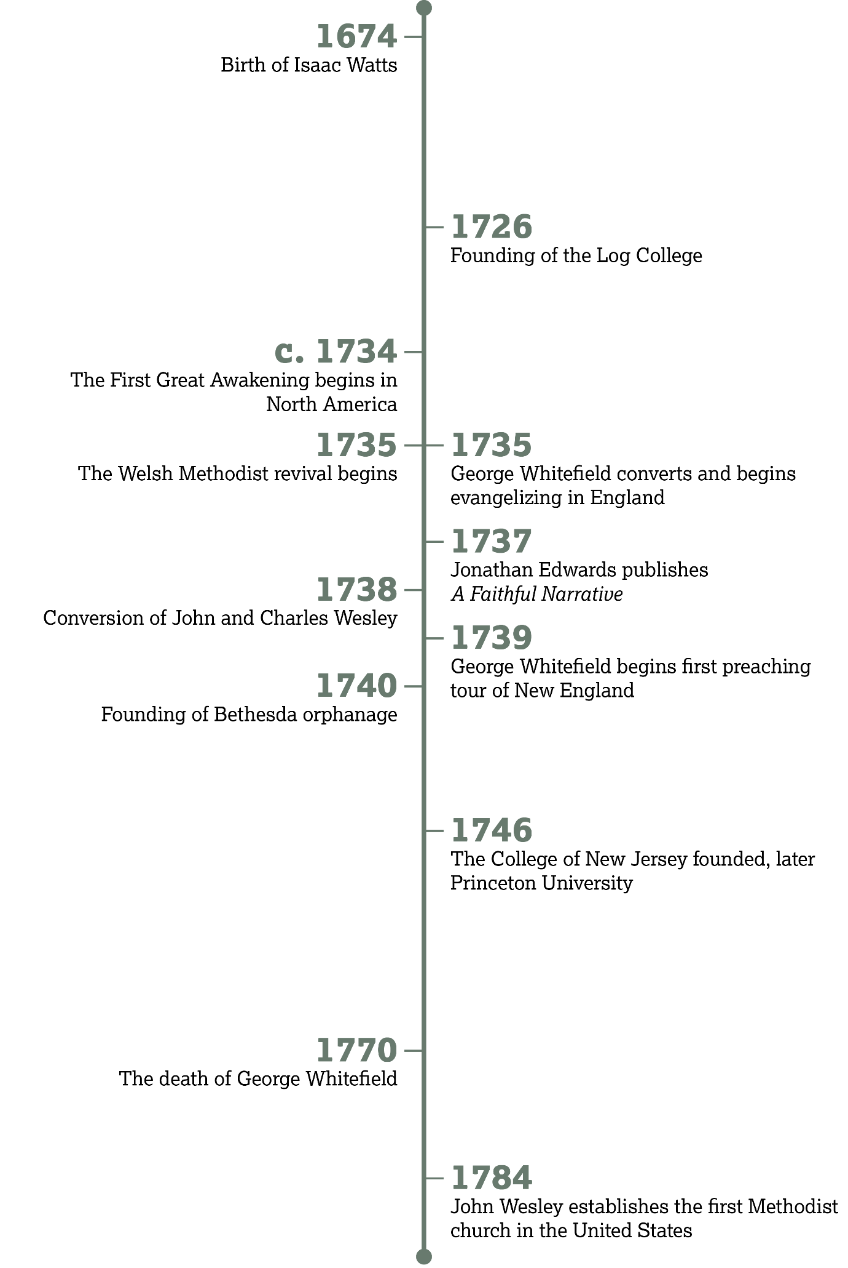

Slide 4
The Reviving Work of the Spirit
Introduction:

Slide 5
Revival in the Bible

Slide 6
Psalm 85:1–5
What is God’s attitude toward sin and iniquity among His people (vv. 3, 5)?
  Wrath, anger

Slide 7
Psalm 85:1–5
How does God respond
to repentance from His
people (vv. 2–3)?
  He gives forgiveness
  and removes His wrath.

Slide 8
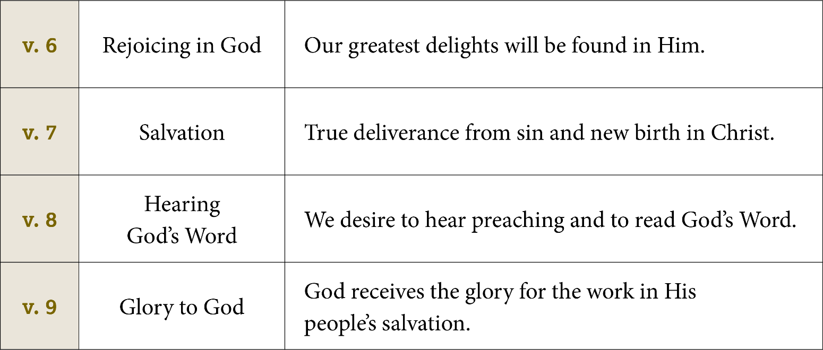

Slide 9
Psalm 85:10–13
According to verse 10, what four virtues accompany revival?
  (1) Love/mercy,
  (2) faithfulness/truth,
  (3) righteousness,
  (4) peace

Slide 10
How could a revived walk with God bring about these virtues in your community?

Slide 11
Revival in Britian

Slide 12
. . . a necessity was laid upon me to lift up my voice like a trumpet to all professors to examine their profession, and to make a close search in what the foundation of their religion and faith was seated . . .
—Howell Harris

Slide 13
Romans 10:1–4
Which verse teaches that a person can have religious zeal without true knowledge of God?
  Verse 2

Slide 14
Romans 10:1–4
The passage describes two places where people seek righteousness. What are those two places?
  Self (in one’s own efforts) or God (in Christ)

Slide 15
Romans 10:1–4
Where are you placing your trust in finding righteousness before God?

Slide 16
Why is it tempting to seek righteousness through works instead of faith in Christ? What part does pride play in this?

Slide 17
If we could earn our own righteousness, who would get the credit for our salvation?

Slide 18
Revival in the American Colonies

Slide 19
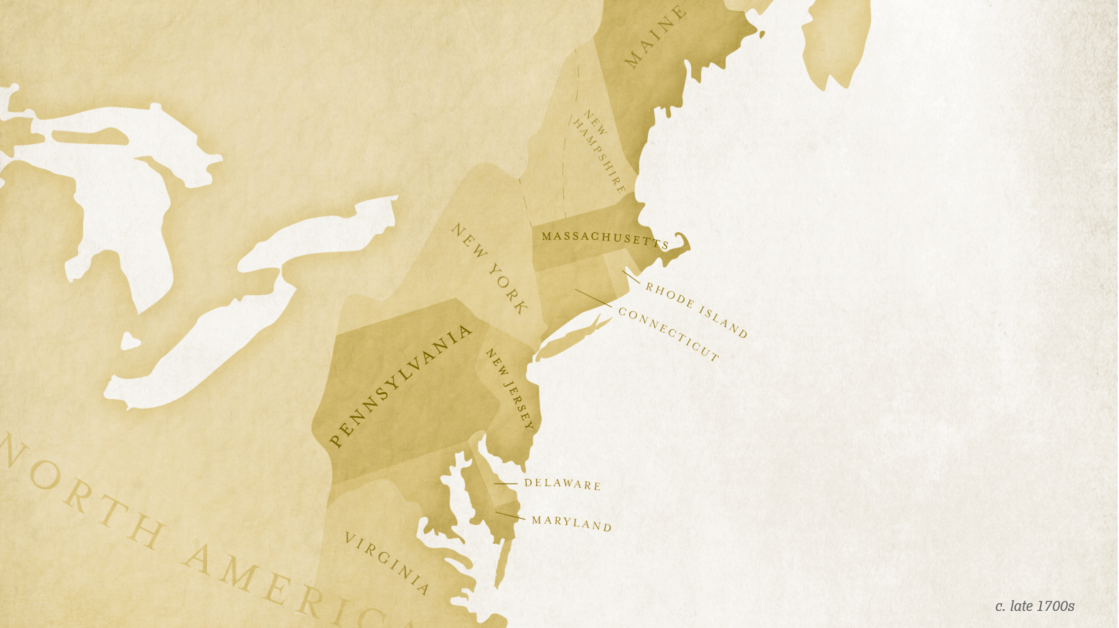

Slide 20
. . . the assembly in general were, from time to time, in tears while the word was preached; some weeping with sorrow and distress, others with joy and love, others with pity and concern for the souls of
their neighbors.
—Jonathan Edwards,
A Faithful Narrative of the
Surprising Work of God

Slide 21
O I could preach till I preached myself dead; I could be glad to preach myself dead, if God would convert you!
—George Whitefield

Slide 22
Psalm 85:11–13
In your own words, how does the psalmist describe the blessings of revival on a land?
  The nation affected by revival will experience an increase in righteousness and even material blessing from the Lord.

Slide 23
Philis Wheatley,
“On the Death of Rev. Mr. George Whitefield”
Further Reading:

Slide 24
Phillis Wheatley,
“On the Death . . .”
Based on the quotations that Wheatley puts in her poem, what did she perceive as the main thrust of Whitefield’s sermons?
  He called people to look to Christ in faith for salvation.

Slide 25
What does Wheatley commemorate about Whitefield in her poem?
According to Wheatley, what hope did Whitefield offer to all who would take Jesus Christ as their savior?

Slide 28
A Century of Song
CHAPTER 9

Slide 29
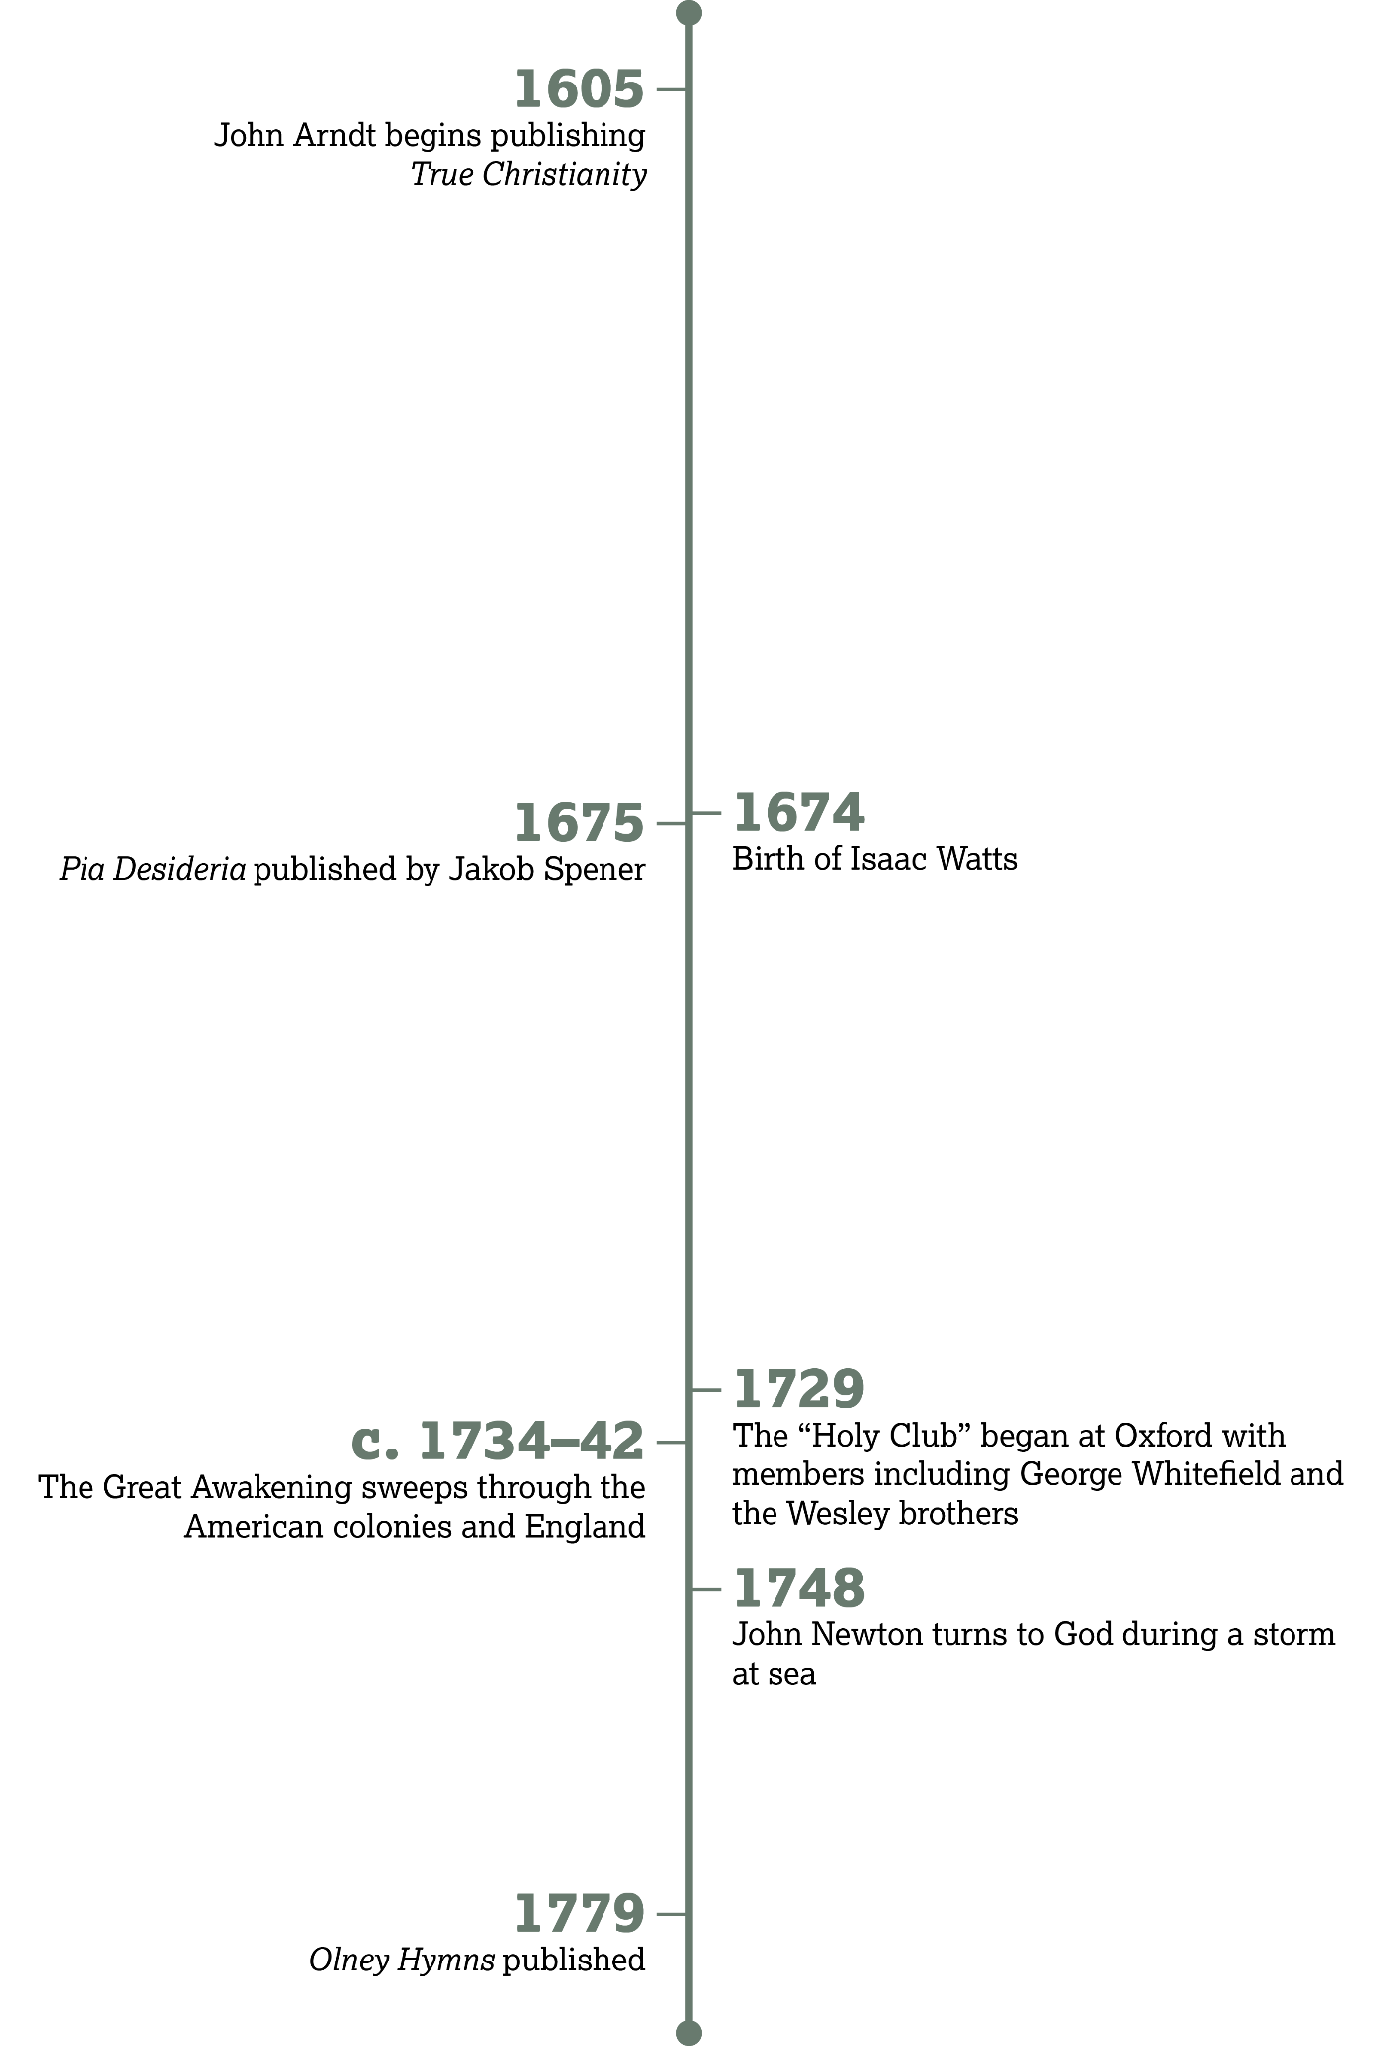

Slide 30
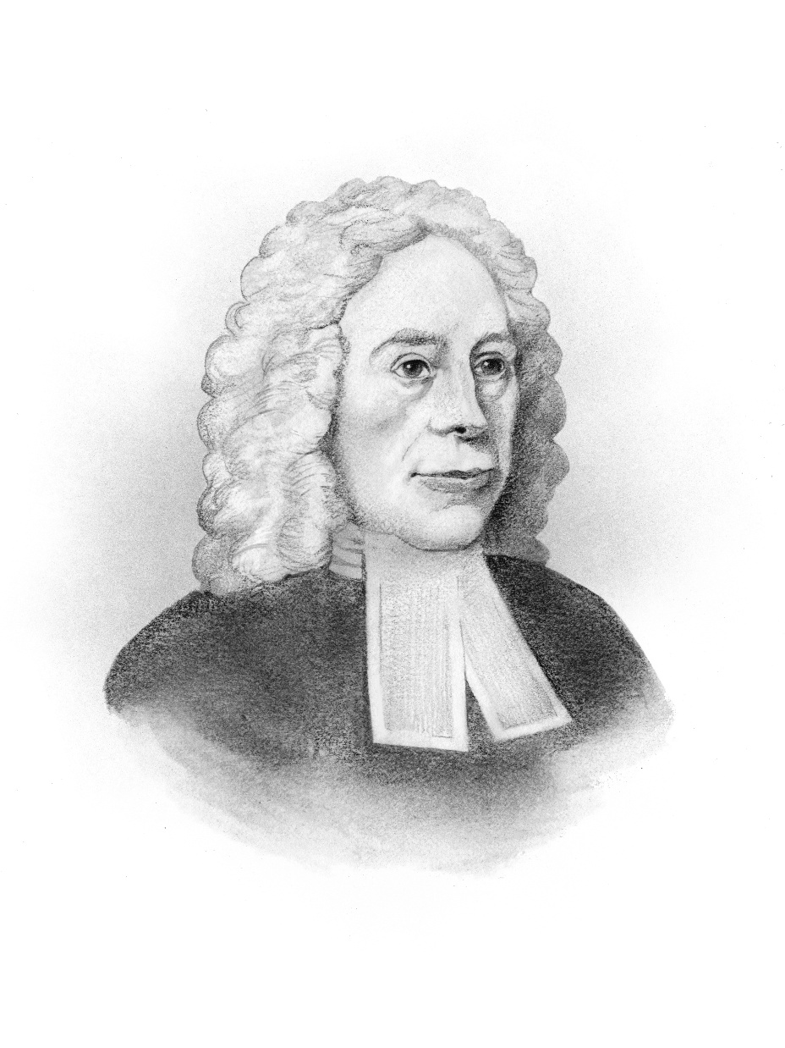
Hymn
Writers
Introduction:

Slide 31
Singing as Part of Sanctification

Slide 32
Eph. 5:18–21; Col. 3:15–17
List some of the similarities between these passages.
  Both contain instructions to sing. Both reference a variety of types of singing—“psalms, hymns, and spiritual songs.” Both say that our singing should be “in the name of our Lord.” Both end with the giving of thanks.

Slide 33
Singing as Part of Sanctification
Why may Wesley have wanted people to sing the hymns exactly as they were written?
  Wesley may have wanted everyone to learn to sing the songs exactly the same way so that everyone could sing together in unity.

Slide 34
Singing as Part of Sanctification
What do you think Wesley meant by “songs of Satan”?
  The worldly songs people sang before they were saved

Slide 35
Singing as Part of Sanctification
Out of the fourth, fifth, and sixth directions, which is the most challenging for you personally? Why?

Slide 36
God’s People
Sing Together

Slide 37
God’s People Sing Together
Think about some of your favorite songs. What truths do they declare about God?

Slide 38
How does Newton describe himself? We were all in this state before salvation, but God loved us.

Slide 39
God’s People
Sing Praise

Slide 40
Colossians 3:15–17
How many times is thanksgiving mentioned?
  Three times, once in each verse

Slide 41
Colossians 3:15–17
Where should this thankfulness be directed?
  To God

Slide 42
God’s People
Sing Truth

Slide 43
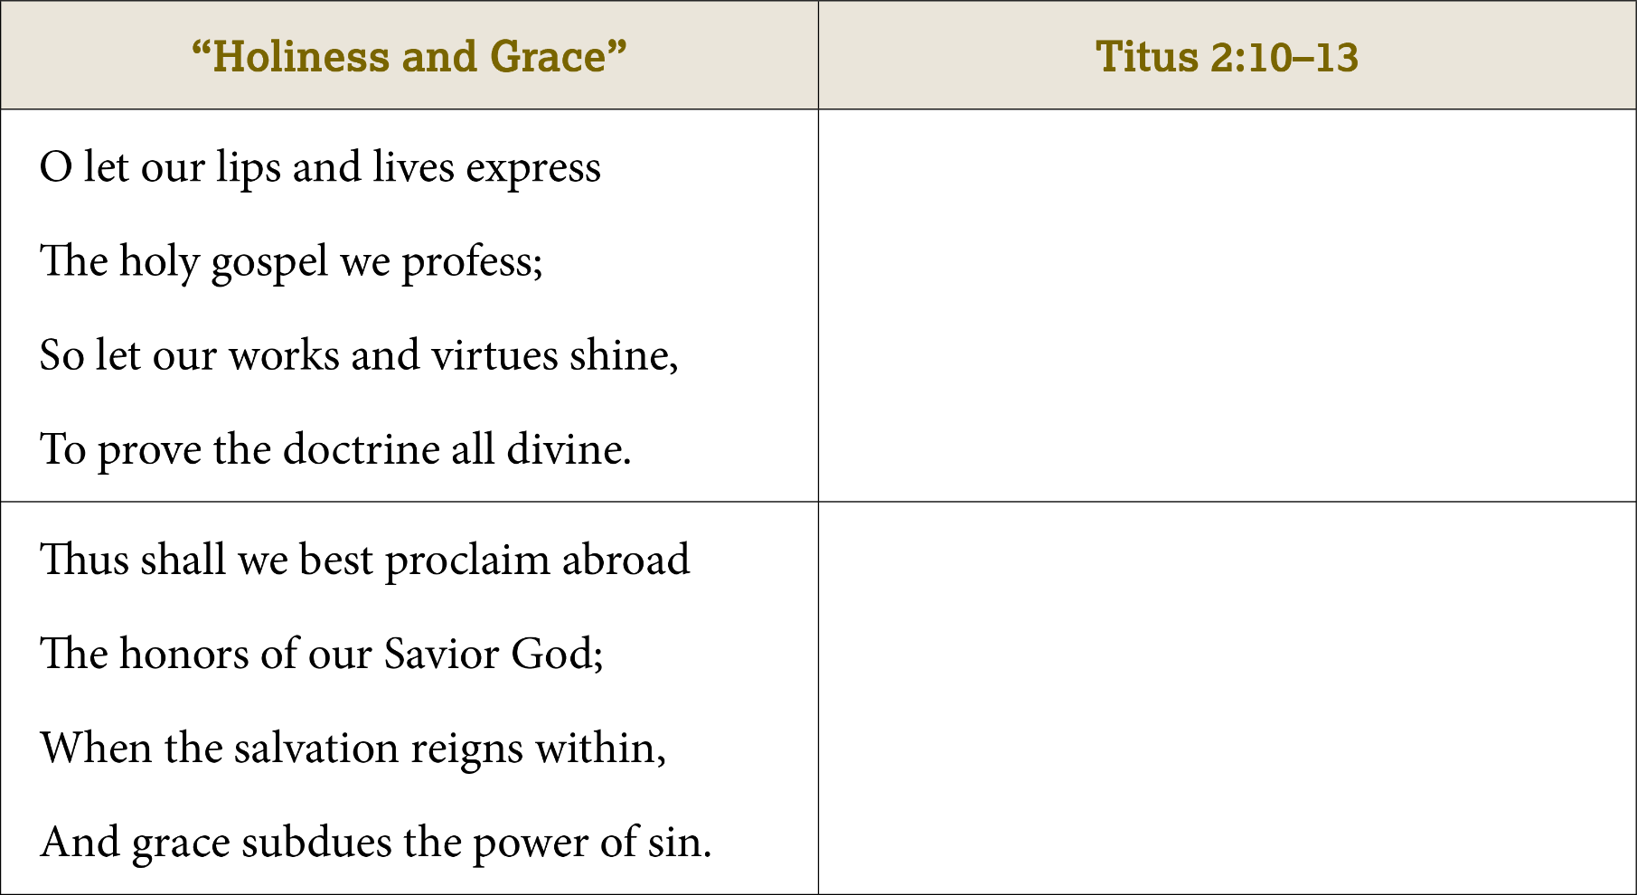
v. 10—We are called to adorn the
doctrine of God (lines 3–4).
v. 10—God is our Savior (line 2).
v. 11—God’s grace brings salvation (lines 3–4).

Slide 44
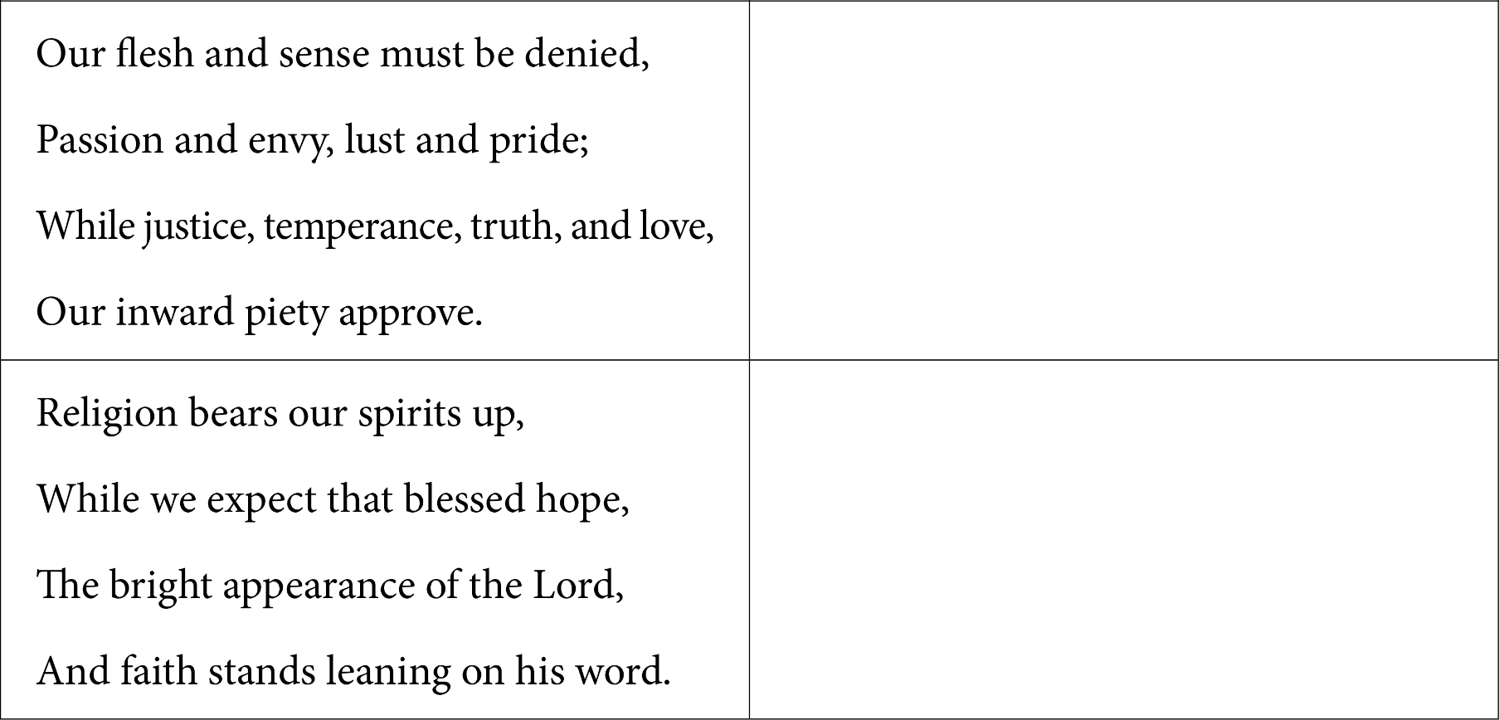
v. 12—We are to renounce (deny)
ungodliness (lines 1–2).
v. 12—We are to live self-controlled, upright, and godly lives.
v. 13—We await the blessed hope and God’s glorious appearing
(lines 2–3).

Slide 45
God’s People Sing Truth
Why is it important for us to measure our songs and hymns by the standard of God’s Word?
  Human experience and creativity can inadvertently introduce false ideas into songs. God’s Word provides the only sure measure of truth.

Slide 46
William
Cowper
Further Reading

Slide 47
William Cowper, “God Moves in a Mysterious Way”
How might Cowper’s struggles with depression and personal loss have influenced this hymn?
  He experienced the need for faith in dark times.

Slide 48
William Cowper, “God Moves in a Mysterious Way”
Where does this hymn point the believer when he or she needs confidence and comfort?
  It points to the sovereign power and goodness of God.

Slide 49
William Cowper, “God Moves in a Mysterious Way”
What circumstances in your own life appear to be a “frowning providence”?

Slide 50
Which verses in Cowper’s hymn do you find most encouraging? Why?
What thought expressed in this hymn could you share with someone else to encourage them?

Slide 53
Attempting Great Things for God
CHAPTER 10

Slide 54
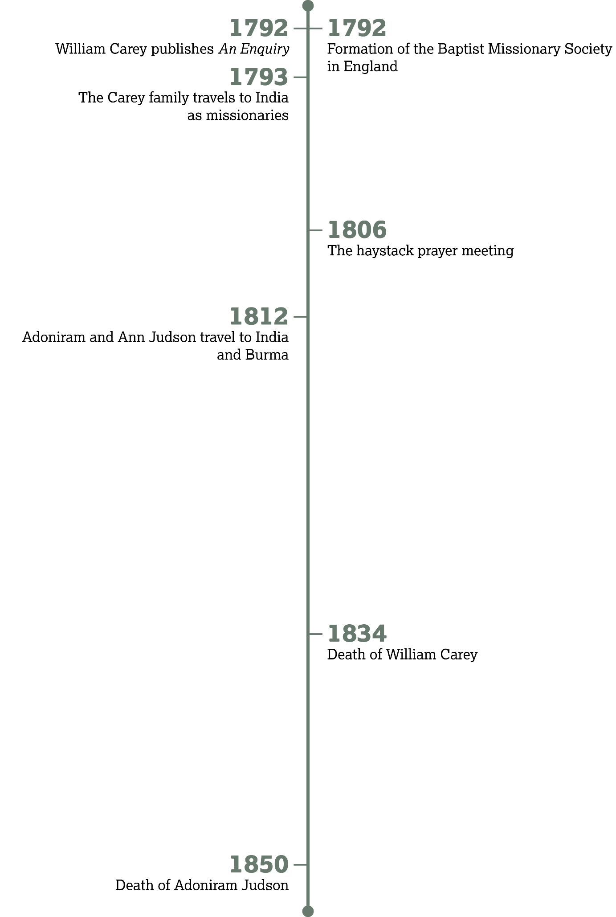

Slide 55
The Careys
Introduction:

Slide 56


Slide 57
Sent to Minister

Slide 58
Acts 13:1–3
How many prophets and teachers are listed in verse 1?
  Five

Slide 59
Acts 13:1–3
How many are set apart for God’s mission work in verse 2?
  Two

Slide 60
Acts 13:1–3
What two things did the group do before sending out Paul and Barnabas in verse 3?
  They fasted and prayed.

Slide 61
Sent to Minister
Name some specific ways you could “hold the ropes” of a missionary your church supports.

Slide 62
Sent to Minister
Are you willing to serve as a missionary if God would clearly lead in that direction?

Slide 63
Sent with Prayer

Slide 64
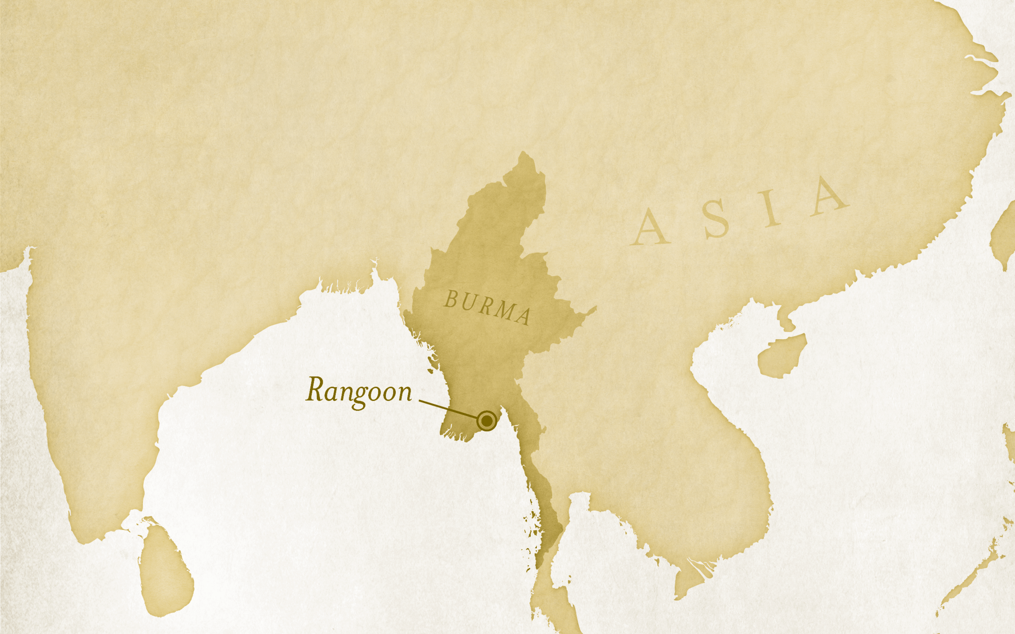

Slide 65
Ephesians 6:18–20
How did Paul ask the Ephesians to pray for him?
  Paul asked for the right words to speak and for fearlessness in his ministry.

Slide 66
Ephesians 6:18–20
What are some ways you could pray for missionaries supported by your church?

Slide 67
Sent Preaching the Word

Slide 68
Acts 13:1–5
According to verse 5, what was Paul’s first activity upon arriving in the city of Salamis?
  He proclaimed the Word of God.

Slide 69
Adoniram
Judson
Further Reading:

Slide 70
Adoniram Judson
What was significant about the Burman that Judson met?
  He was the first Burman that Judson met who acknowledged the one eternal God.

Slide 71
Adoniram Judson
What did Judson give to the Burman?
  A tract, a catechism, and a partial translation of the Gospel of Matthew

Slide 72
Imagine you oversee translating the Bible into a language that does not currently possess any Scripture.
What book of the Bible would you translate first and why?

Slide 73
Adoniram Judson
Judson alluded to a limited paper supply. In what ways do you think modern technology has helped Bible translation?

Slide 76
The Gospel Mobilized
CHAPTER 11

Slide 77
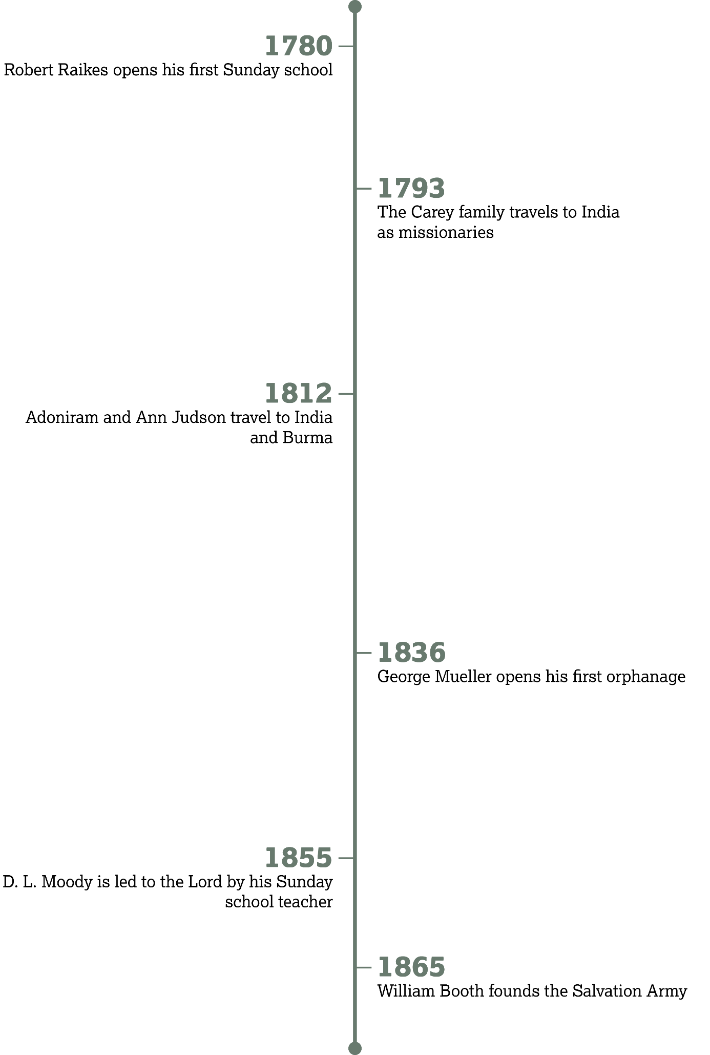

Slide 78
Alleviating
Human
Suffering
Introduction:

Slide 79
The Undeserving Seeking the Undeserving

Slide 80
Luke 14:1–6
How did Jesus show that caring for people is more important than religious tradition?
  He healed the man even though it was the Sabbath, a day on which tradition forbade healing.

Slide 81
Luke 14:7–11
How were the people
exhibiting pride?
  The people fought to get the best seats.

Slide 82
Luke 14:7–11
According to verse 11, what typically happens to people who exalt themselves?
  God will humble them.

Slide 83
Go straight for souls, and go for the worst.
—A Sign in the Salvation Army Headquarters

Slide 84
Luke 14:12–14
What practical way did Jesus suggest that the host could reflect the grace of God?
  He could invite people to his banquet who couldn’t pay
  him back.

Slide 85
You may not be inviting people to feasts, but you can still show grace. What are some ways this could translate into ministry today?

Slide 86
The Evangelists

Slide 87
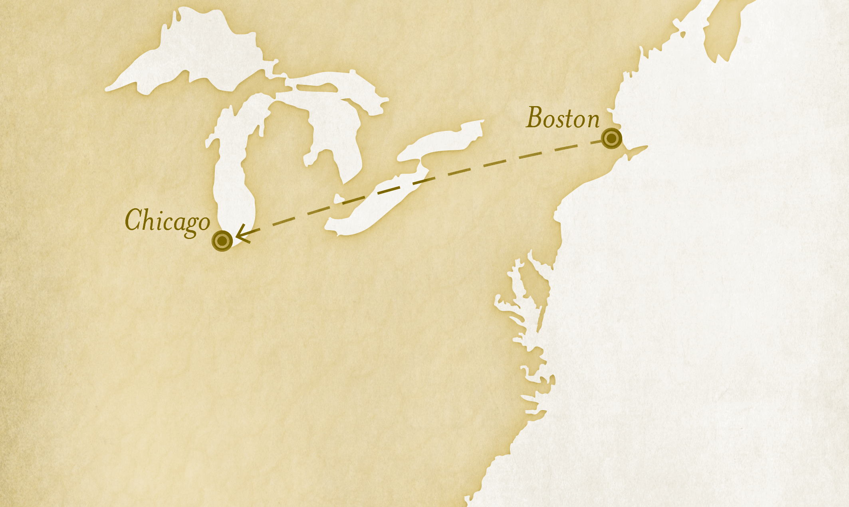

Slide 88
Luke 14:15–17
Was this a small banquet?
  No

Slide 89
Luke 14:15–17
What message did God give the servant to announce?
  Come, for everything is
  now ready.

Slide 90
Luke 14:18–20
Beside each category of distraction, list the specific example Jesus gave. Then, list some modern-day examples in each category that may distract people from the gospel today.
  Property: a field—a car, house,
  or device

Slide 91
Luke 14:18–20
Beside each category of distraction, list the specific example Jesus gave. Then, list some modern-day examples in each category that may distract people from the gospel today.
  Possessions/Wealth: oxen—money, entertainment, hobbies

Slide 92
Luke 14:18–20
Beside each category of distraction, list the specific example Jesus gave. Then, list some modern-day examples in each category that may distract people from the gospel today.
  Relationships: a wife—friends, classmates, coworkers

Slide 93
Luke 14:21–24
In your own words, describe the kinds of guests who finally filled the banquet hall.
  They were the poor and weak, people often overlooked and ignored by society.

Slide 94
Luke 14:21–24
How should this parable influence the way you share the gospel—God’s invitation?
  It should remind us that we need to be giving the gospel to everyone. We shouldn’t prescreen someone before telling them about Jesus.

Slide 95
But I want to say right here, don’t any one of you go out saying the Son of God never sought for your soul.
—D. L. Moody

Slide 96
Look at James 1:27 and discuss how it applies to the theme of this lesson.

Slide 97
Angelina Grimke,
“An Appeal to the Christian Women of the South”
Further Reading:

Slide 98
Angelina Grimke, “An Appeal to the Christian Women . . .”
In your own words, summarize the case that the Grimke sisters make from Scripture to protest the practice of slavery.
  Nowhere does Scripture say that God gave humans supreme dominion over other humans.

Slide 99
Angelina Grimke, “An Appeal to the Christian Women . . .”
What “ultimate appeal” in the excerpt above should be the guiding standard for every action we undertake?
  The Bible

Slide 100
What is one injustice or need in society that you think Christians should do more to address?
What arguments could you make from Scripture to protest and critique this issue?

Slide 103
The Battle with Theological Liberalism
CHAPTER 12

Slide 104
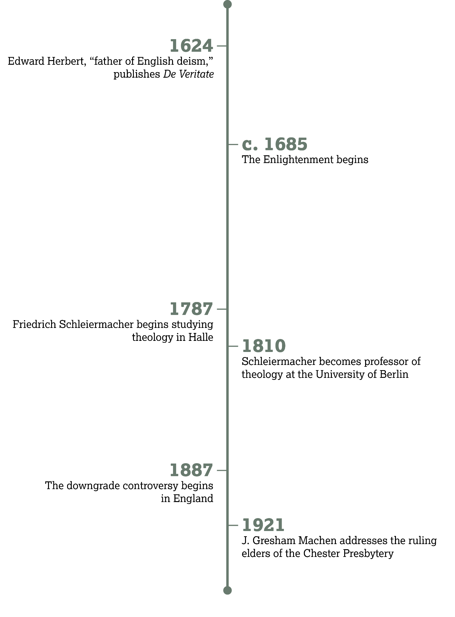

Slide 105
Opposing
False Teaching
Introduction:

Slide 106
The Foundation of Truth

Slide 107
Jude 1–3
How does Jude describe Christians in verse 1?
  They are described as loved, preserved/kept, and sanctified
  by God.

Slide 108
Jude 1–3
How did the church receive the message of faith (v. 3)?
  It was delivered or entrusted to us.

Slide 109
Jude 1–3
How often was the Christian faith delivered (v. 3)?
  Once for all

Slide 110
Jude 1–3
If God delivered it only once, how should Christian doctrine in the twenty-first century compare to Christian doctrine in the
first century?
  They should be the same.

Slide 111
How Error
Creeps In

Slide 112
Jude 4
What are some ways that forcing our own interpretation on Scripture could undermine Jesus as our Lord?
  We may reject His commands and replace them with our own preferences.

Slide 113
Jude 16
Summarize how Jude describes ungodly false teachers in this verse.
  They are complainers consumed with their own desires.

Slide 114
Too many ministers are toying with the deadly cobra of “another gospel,” in the form of “modern thought.”
—C. H. Spurgeon,
“Another Word Concerning
the Downgrade”

Slide 115
Responding to False Teaching

Slide 116
Jude 5–7
What three groups experienced God’s judgment?
  Verse 5: The Israelites who didn’t trust God in the wilderness
  Verse 6: The angels who joined Satan’s rebellion
  Verse 7: Sodom and Gomorrah

Slide 117
Jude 10–12
Look up the following passages and write the name of the person who engaged in false worship.
  Gen. 4:3–12: Cain
  Num. 16:1–11, 25–34: Korah
  Num. 31:16, 25:1–3; 31:8: Balaam

Slide 118
Jude 17–19
Who warned that false teachers would arise?
  The apostles

Slide 119
Jude 17–19
How can God’s foreknowledge encourage us?
  If God knows all the falsehood that will arise, He in wisdom and love also provides us with the means of overcoming that falsehood with truth.

Slide 120
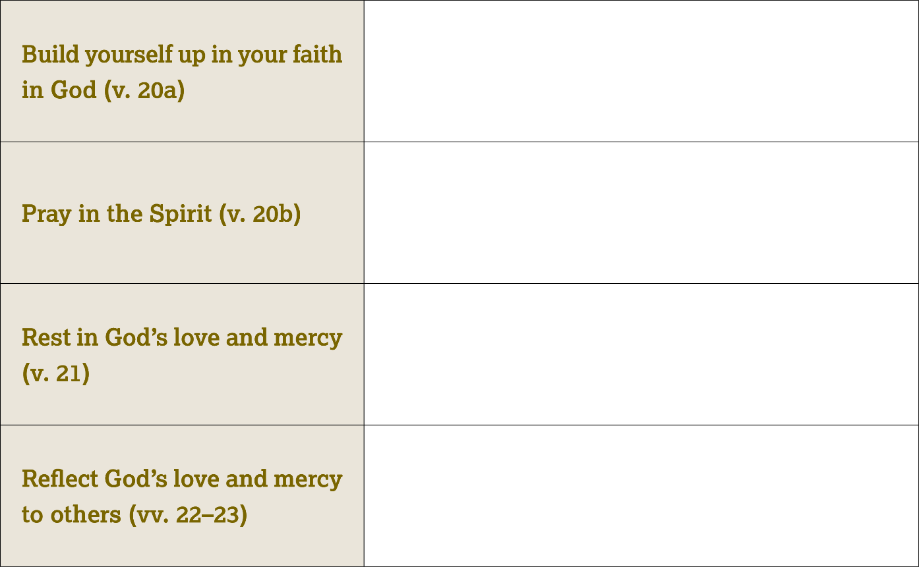
Study the Bible; listen to sermons.
Keep a prayer list; set aside a time each day for prayer.
Share some ways I am thankful for God’s goodness; share my fears and worries with God in prayer.
Share the gospel; reach out to those who are hurting.

Slide 121
Charles H.
Spurgeon
Further Reading

Slide 122
Charles H. Spurgeon
Did Spurgeon perceive that doctrinal purity in churches was on the rise or decline?
  The decline

Slide 123
Charles H. Spurgeon
What doctrines were being denied?
  The atonement, the inspiration of Scripture, the personhood of the Holy Spirit, punishment of sin, the resurrection

Slide 124
Do you think a true Christian can be led astray by false teaching?
How can you equip yourself to more readily identify false teaching?

Slide 127
To Every Tribe and Tongue
CHAPTER 13

Slide 128
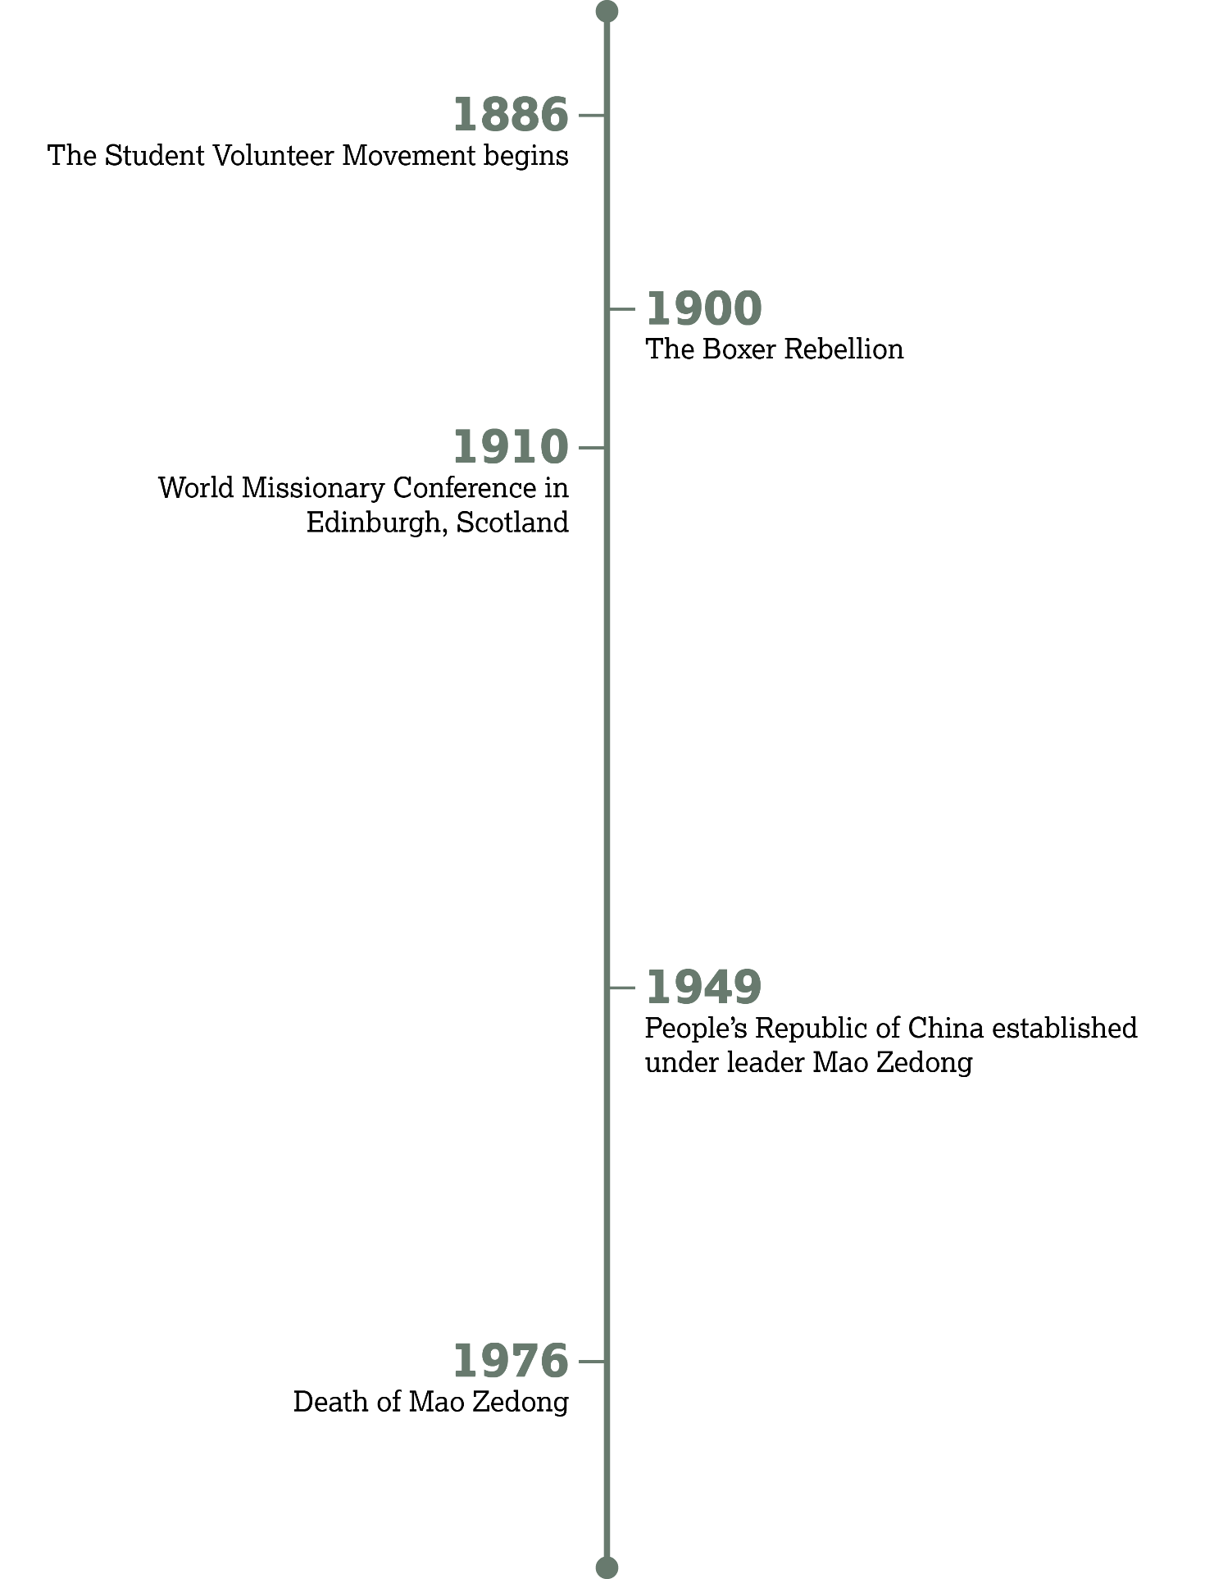

Slide 129
1910 World Missionary Conference
Introduction:

Slide 130
The Grand Vision

Slide 131
Revelation 7:9
How many Gentiles were before the throne of God?
  Too many to number

Slide 132
Revelation 7:9
Where were they from?
  Everywhere; every nation and tribe on the earth

Slide 133


Slide 134
How would you respond to this level of persecution?
How could you continue to worship God if the government of your country declared it illegal?

Slide 135
Praising God in Every Language

Slide 136
Revelation 7:10–14
According to verses 10 and 14, what are the people praising
God for?
  Their salvation

Slide 137
Revelation 7:10–14
Look again at the angels’ words in verses 11–12. What do their words tell us about God?
  God deserves all praise and glory because no one else can compare to His power and might. His reign is eternal and indomitable.

Slide 138
Praising God in
Every Language
What are two ways you could learn more about believers in other countries this week?

Slide 139
Together Forever with Christ

Slide 140
Revelation 7:15
What will believers do in eternity?
  Serve God continually

Slide 141
Revelation 7:15
What will God do for believers?
  Shelter them

Slide 142
Revelation 7:17
How does God picture the end of suffering and the eternal joy awaiting us?
  He wipes away every tear.

Slide 143
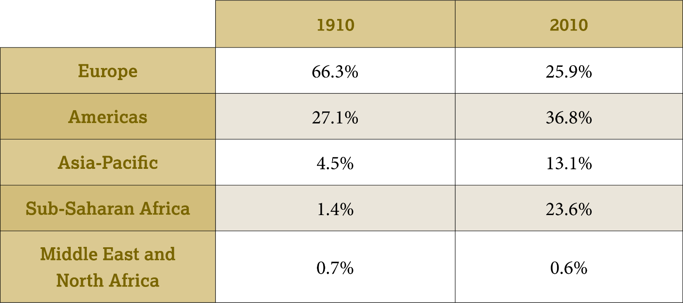
Population of Christians Around the World

Slide 144
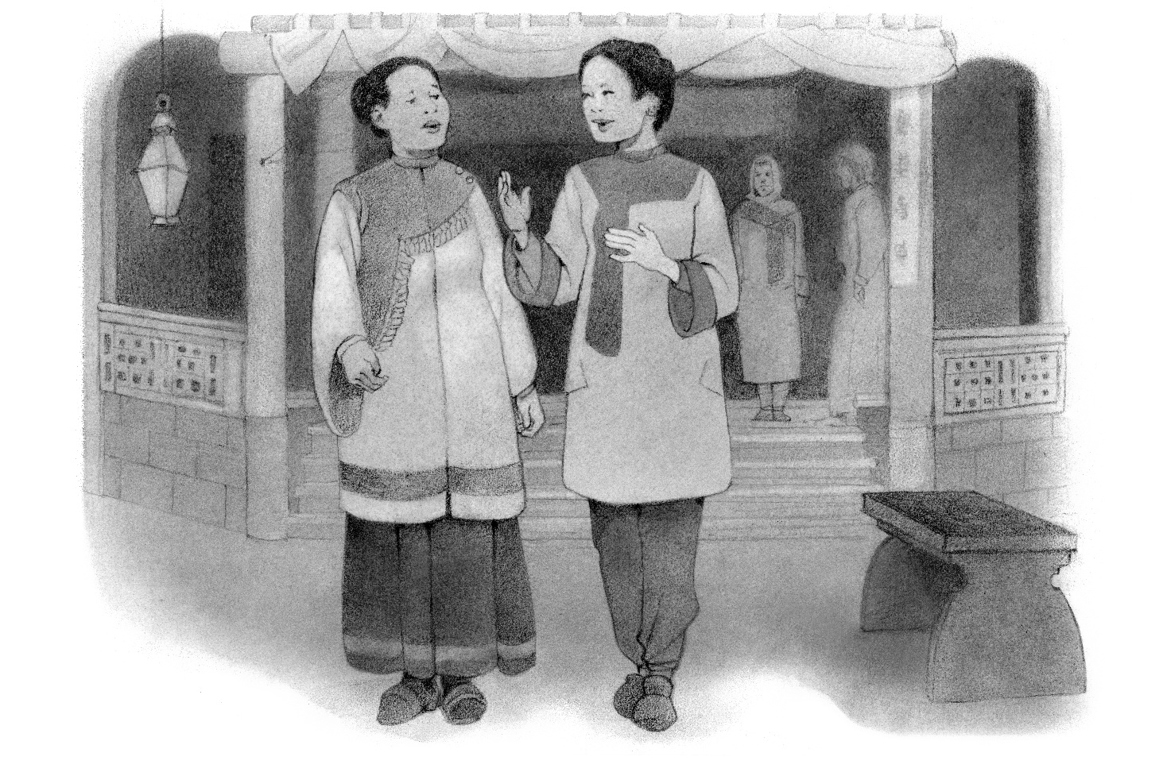
Dora Yü
Further Reading

Slide 145
Dora Yü
How would you summarize what Dora Yü was thankful for? What did she consider a blessing?
  She was thankful for her trip and her fellowship with other Christians. She was blessed to see believers committing themselves to growing in their faith.

Slide 146
Dora Yü
What enemy did she consider at war with the Church? Why?
  Higher criticism. By removing Christ from the gospel, it removes the believer’s hope of salvation.

Slide 147
Dora Yü
What type of people does she pray that God will provide to oppose this enemy?
  True witnesses who are willing to stand true to God and fearlessly share His Word, exposing false teaching.

Slide 148
If a Christian from another country were to visit you in your country, how do you think the visitor would characterize the spiritual climate where you live?
What might that foreign believer see as positive? What might he or she see as negative?

